Slide 1
Improving Multiresource Job Scheduling with Markovian Service Rate Policies
Zhongrui (reads John-Ray) Chen¹, Isaac Grosof², Benjamin Berg¹
¹University of North Carolina at Chapel Hill, ²Northwestern University
ACM SIGMETRICS 2025
Jun 10, 2025

Slide 2








A Wide Variety of Workloads Run in Data Centers
Multiresource Jobs
Serverless
Cloud Instances (AWS, Azure, etc.)
Data Analytics
Notes:
In general, a wide variety of workloads like serverless applications, cloud instances and HPC runs in data centers.
These workloads usually require a few CPU cores, some memory, some disk space and sometimes specialized hardware like GPUs in order to run.
We call these multiresource jobs.
A given server in the data center can run a set of these jobs in parallel, as long as it has enough resources to satisfy all jobs it is running.
Animation: Display multiresource jobs directly on the server, no sliding

Slide 3


An example on multiresource scheduling
Response time, $T$
Job arrivals
Question: How to schedule these multiresource jobs to reduce mean response time, $𝔼\left[T\right]$?
Notes:
For each job that arrives on the system, we can measure its mean response …
In today’s talk, our question is xxx
Schedule (2, 0) (0, 3) (1, 1)
Resource demands (2, 2), (3, 1)
Language: Gigabytes of DRAMs instead of RAMs
How to schedule these jobs to reduce the long run average response time for an infinite stream of arriving jobs.
Animation: 2 blue jobs animation

Slide 4
Why is data center scheduling hard?
Response time, $T$
Job arrivals
Example: Each job takes 1 second
First-Come First Served (FCFS)
FCFS completes 2 jobs/sec
Can a smarter policy beat FCFS?
All blues: 3 jobs/sec
All oranges: 2 jobs/sec
Hard: Exponentially many schedules to choose from. Which schedules to choose? When do we switch?
Notes:
What smarter policy did was it chose a good set of schedules to run and switch
This is a simple example, but in general xxx

Slide 5

Our goals
Response time, $T$
Job arrivals
Goal 1: Find a throughput-optimal policy: stabilize the system whenever possible.
Stable: complete jobs fast enough to get a finite $𝔼[T]$
Goal 2: Handle limited or no preemptions.
Goal 3: Analyze its mean response time, $𝔼[T]$.
Notes:
If jobs are fully preemptible, then we can switch at any time.
Unfortunately, preemptions are not always available ….

Slide 6
Prior Works on Multiresource Scheduling
 | Goal 1: Throughput-optimal | Goal 2: Preemption | Goal 3: Response Time Analysis
FCFS | No | Non-preemptive | Bounds [Performance’ 23]
MaxWeight [INFOCOM’ 12] | Yes | Preemptive | Heavy traffic only
Randomized Timer [INFOCOM’ 16] | Yes | Non-preemptive | No
Markovian Service Rate (MSR) [SIGMETRICS’ 25] | Yes | General | Additively-tight bounds
Notes:
Randomized Timers: 1. throughput-optimal and non-preemptive 2. we take gradient steps towards MaxWeight at random moments in time so that we don’t have to solve the complex knapsack problem in MaxWeight. 3. drawback: approximating MaxWeight, hard to predict schedules
MaxWeight: tries to solve a binpacking problem to find efficient packings. To avoid the pitfalls of serving some job but starving others, like the example we saw earlier, we need to serve green jobs if they are piling up in the system. MaxWeight tries to address this problem by putting more weights on greens if there are a lot of them. This makes the policy switch between different schedules depending on which jobs are in the system. As a result, the MaxWeight policy may switch the schedule every time there is an arrival or a completion. This requires preempting jobs that are already in service. Moreover, finding a solution to the binpacking problem here is complex and the schedules we are using cannot be known beforehand. This complicates the response time analysis. We only have results in heavy traffic.
FCFS is a simple, easy-to-implement, and non-preemptive policy that continuously admits jobs from the front of the queue until we run out of resources. As a result, we may run into inefficient packings, causing the system to become unstable. The switching process of FCFS is heavily dependent on the arrival order, therefore analyzing this policy is hard. Only recently, we have bounds on FCFS.
To avoid the computational complexity of MaxWeight, people developed a non-preemptive policy called Randomized Timers, a policy that approximates MaxWeight packing using probabilistic algorithms. Randomized Timers is throughput-optimal because it is finding similar packings to MaxWeight. However, analyzing its response times is even more difficult than MaxWeight because the packing it chooses is decided by random process and we have no idea that is going to look like.

Slide 7




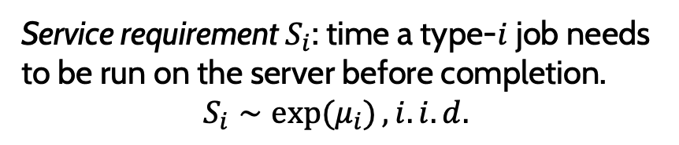


Our Multiresource Job Model
We assume there are $K$ types of jobs.
Type-1
Type-2
Type-1
$$S_{1}$$
Poisson($λ_{1}$)
Type-2
$$S_{2}$$
Poisson($λ_{2}$)
Service requirement $S_{i}$: time a type-$i$ job needs to be run on the server before completion.
$$S_{i}∼\exp{(μ_{i})}, i.i.d.$$
Arrival rate vector $λ=\left(λ_{1},λ_{2},…,λ_{K}\right)$.
Notes:
In our multiresource job model, we care about this response time T, which is the time from when as job arrives until it completes.
Note that the orange jobs share the same resource demands, hence we group the jobs into types by resource demands.
We assume that there are K types of jobs in the system.
We assume type-I jobs arrive according to a Poisson process with rate lambda_i.
We also define the service requirements of type-I jobs as S_i, which is (repeat).
We assume this is i.i.d. exponentially distributed with rate mu_i.
Earlier, we said the system has wastage, therefore it is not work conversing.
In this case, it is hard to even characterize the stability region, which is the set of cases such that mean response time is bounded.
The stability region depends on how wasteful we are on resources.
Hence, our goal is to design a policy that reduces wastage to maximize the stability region while giving analyasis on its mean response time E[T].

Slide 8





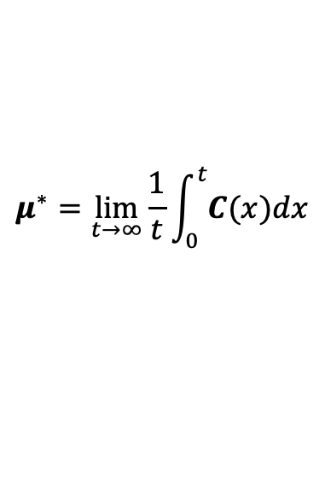

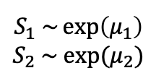



Our Multiresource Job Model
Instantaneous completion rate $C\left(t\right)=(C_{1}(t),C_{2}\left(t\right),…,C_{K}(t))$
Type-1
$C_{2}$ (jobs/sec)
$$⁡({0, 2μ}_{2})$$
$$⁡(0, 2)$$
Type-2
$$S_{1} \sim \exp\left(μ_{1}\right)$$
$$S_{2} \sim exp⁡(μ_{2})$$
$$⁡(1, 1)$$
$$⁡({μ_{1}, μ}_{2})$$
WLOG: We set $μ_{1}=μ_{2}=1$ to simplify the example
$$⁡(3, 0)$$
Long-run average completion rate $μ^{∗}$.
$$⁡(3μ_{1},0)$$
$$μ^{∗}=\lim_{t→∞}{\frac{1}{t}\int_{0}^{t}{C(x)dx}}$$
$C_{1}$ (jobs/sec)
Feasible schedule
Actual completion rate might be lower!
Notes:
When I talk about C(t), I’m talking about the resources we are reserving for each type of jobs.
Therefore, we can view this C(t) as a potential completion rate of the system.
The actual completion rate might be lower, if we don’t have enough jobs of a particular type.
For example, if we want to run 3 blue jobs but only find 1 blue job in the system, we are getting a lower completion rate.
For most our talk, it suffices to argue about this potential completion rate.
We will come back to handle this discrepancy between the potential completion rate and actual completion rate when we talk about response time analysis.

Slide 9


Markovian Service Rate (MSR) Policies
MSR: Switch schedules according to a Continuous-Time Markov Chain
$$x_{1}$$
$$x_{2}$$
Candidate schedules
Candidate schedules
Example: Preemptive MSR policy
We call this CTMC the modulating process.
Notes:
Note: preemption / handle the non-preemptible case later

Slide 10
Goal 1: Throughput-Optimality
Notes:
Now we understand what an MSR policy is. Let’s talk about our 3 goals.

Slide 11






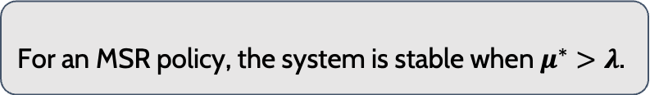



Stability Condition
$λ_{2}$ (jobs/sec)
Long-run average completion rate $μ^{∗}$.
$C_{2}$ (jobs/sec)
$$μ^{∗}=\lim_{t→∞}{\frac{1}{t}\int_{0}^{t}{C(x)dx}}$$
$$⁡(0, 2)$$
Theorem 1 (Stability conditions)
$\text{Average} \text{schedule}$ $μ^{∗}$
For an MSR policy, the system is stable when $μ^{∗}>λ$.
$$⁡(1, 1)$$
$$λ=⁡(2, 0.6)$$
$λ_{1}$ (jobs/sec)
$$⁡(3, 0)$$
$C_{1}$ (jobs/sec)
$$x_{1}$$
$$x_{2}$$
Notes:
TODO: record this slide
Component-wise larger
Expand the intuition of theorem 1.
Next, we investigate the case where an MSR policy can stabilize the system.
We formalize the intuition that jobs need to complete faster than they arrive to stabilize the system in Theorem 1, which says the system is stable whenever mu^*>lambda.
Since the units agree, we can put the arrival vector lambda on this plot as well.
That is, mu^* needs to lie in this shaded region for the system to be stable.
We prove theorem 1 following a Lyapunov drift style argument.

Slide 12

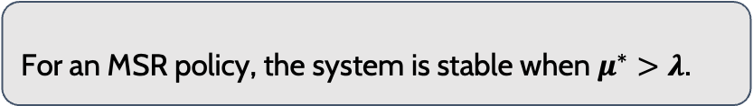






Preemptive MSR is Throughput-optimal
Theorem 1 (Stability conditions)
$λ_{2}$ (jobs/sec)
$C_{2}$ (jobs/sec)
For an MSR policy, the system is stable when $μ^{∗}>λ$.
$$(0, 2)$$
Theorem 2 (Preemptive)
The class of preemptive MSR policies is throughput-optimal.
$\text{Average} \text{schedule}$ $μ^{∗}$
$$(1, 1)$$
$$λ$$
$$(3, 0)$$
Proof Sketch:
$λ_{1}$ (jobs/sec)
$C_{1}$ (jobs/sec)
Step 1: $λ$ in grey area is necessary for stability
Step 2: for any $λ$ in grey, want MSR policy with $μ^{∗}>λ$
Step 3: extend $λ$ to intersect with the boundary and get $μ^{∗}$
Convex hull [Maguluri 2013] of all feasible schedules
Step 4: $μ^{∗}$ is a convex combination of feasible schedules
Exists CTMC with corresponding schedules and limiting distribution
Notes:
Say preemption twice.
We will see this thru an example. Here, the red dot represents an arrival rate vector. We want an MSR policy that produces an average schedule that lies above this lambda. If we extend lambda to intersect with the boundary and take this intersection point as mu^*, it suffices to show that exists an MSR policy that can produce this average schedule to finish the proof.
TODO: record this slide
For a convex combination of points, we can construct a modulating process that corresponds to this set of points and the respective weights.
`Now, let’s investigate the case that jobs are preemptible.
We know from earlier that the system is stable whenever mu^*>lambda.
We can therefore show that whenever possible, there exists an MSR policy that can stabilize the system.
Here is our constructive proof.
From Maguluri 2013, lambda has to be in this convex hull of the feasible schedules in order to stabilize the system.
(Added) Intuitively this makes sense by theorem 1 because this is the set of points where we can find a set of schedules such that the mu^* is larger than lambda.
As a construction, we pick the intersection between the direction of the arrival rate vector of the convex hull to find a mu^* that lies above lambda.
Next, we find a convex combination of feasible schedules that produces this mu^*.
We can therefore build a modulating process by picking these feasible schedules and setting the corresponding transition rates so that mu^* is the intersection point.
Note that there is an alpha in the transition rates because the stationary distribution does not change when we vary alpha.
Consequently, we can set alpha to whatever value we want without moving mu^*.
This is saying that we can choose to preempt however frequent we want.

Slide 13
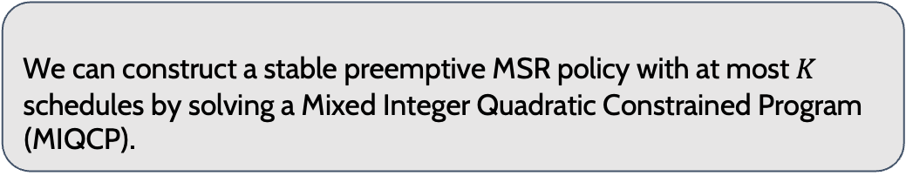
How to Construct a Stable Preemptive MSR Policy?
$λ_{2}$ (jobs/sec)
$C_{2}$ (jobs/sec)
Offline Optimization Problem
Variables: candidate schedules,
limiting distribution of the modulating process
$$(0, 2)$$
Objective function: see full paper
$\text{Average} \text{schedule}$ $μ^{∗}$
Constraint 1: Feasible candidate schedules (green dots)
$$(1, 1)$$
$$(3, 0)$$
Constraint 2: Pick a limiting distribution (probabilities sum to 1)
$$λ$$
Constraint 3: Average schedule lies above $λ$ (Stability condition)
Corollary 3 (Preemptive)
We can construct a stable preemptive MSR policy with at most $K$ schedules by solving a Mixed Integer Quadratic Constrained Program (MIQCP).
Notes:
Add the cone and move the points
Theorem 1 and 2 gave us an existence proof, but did not tell us how to pick a modulating process that stabilizes the system.
Modern integer program solvers are very good at solving MIQCPs
To construct a modulating process, we set up an offline optimization problem.
We need to solve for the feasible schedules we are using, as well as the limiting distribution of the modulating process.
Luckily, Caratheodory’s theorem suggests that we only need as many feasible schedules as the number of job types to produce an average of mu^*.
Therefore, the number of variables in this optimization problem only scales linearly as the number job types.
To ensure that the modulating process we build produces mu^* at this intersection point, we put 4 constraints on this optimization problem.
First, we need to make sure we only pick from feasible schedules. Next, the limiting probability needs to sum to 1.
Thirdly, mu^* needs to lie above lambda for stability. Finally, mu^* needs to lie in the direction of lambda.
Therefore, we can show in Corollary 7 that we can construct an MSR by solving this MIQCP.
The policy Corollary 3 spits out <=K

Slide 14
Goal 2: Handling Non-preemptive Jobs

Slide 15

















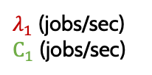











Non-preemptive MSR is throughput-optimal
$λ_{2}$ (jobs/sec)
$C_{2}$ (jobs/sec)
Theorem 4
The class of non-preemptive MSR policies is throughput-optimal.
$$(0, 2)$$
Set $α$ to lower values!
Problem: Non-preemptive MSR needs to wait for job completions
$$s_{3}$$
$$(1, 1)$$
Average schedule $μ^{∗}$
Claim: Can limit the time waiting for completions
$$λ=⁡(2, 0.6)$$
$$(3, 0)$$
$λ_{1}$ (jobs/sec)
$C_{1}$ (jobs/sec)
$$s_{2}$$
$$s_{1}$$
$α$: the overall switching rate of our policy
$${αx}_{1}$$
$${αx}_{1}$$
$$3μ_{1}$$
$$2μ_{1}$$
$$x_{1}$$
$$x_{1}$$
$$s_{1}$$
$$s_{2}$$
$$μ_{1}$$
$$μ_{2}$$
$${2μ}_{2}$$
$$x_{2}$$
$$s_{3}$$
$$x_{2}$$
$${αx}_{2}$$
$${αx}_{2}$$
Preemptive Policy
Non-preemptive Policy
Notes:
What we can show here is that we can design a non-preemptive policy that is not so different from the preemptive policy.
We can rewrite the transition rates on the preemptive policy ….
We show in Theorem 4 that the class of non-preemptive MSR policy is throughput-optimal.
The problem with the preemptive policy is that we need to switch between schedules at arbitrary times. This requires preempting jobs that are already in service.
In the non-preemptive setting, we can only wait for jobs to complete before switching to another schedule.
Therefore, we can add a few states in the preemptive modulating process to account for the time spent waiting on job completions.
We call these states switching states. Unfortunately, some of the switching states run with lower completion rates, dragging this average schedule mu^* down.
We claim that, we can manipulate the modulating process to limit the time spent in those switching states, waiting for job completions.
To do that, let’s first see how we can control the frequency we switch between schedules.
We notice that adding an alpha to all the transition rates in the preemptive process will not change its limiting distribution, thus will not move the average schedule mu^*.
This means we can control the overall switching rate of our policy alpha without moving mu^*.
Similarly, we can add the alphas to x_1 and x_2 in the non-preemptive process.
If we set alpha to a sufficiently low value, then we are almost spending no time in the switching states.
In this case, our non-preemptive process is similar to a preemptive process with a very low overall switching rate.
Because we spend almost no time in the switching states, we can move this average schedule mu^* back up, stabilizing the system again.
This completes the proof.

Slide 16
Goal 3: Response Time Analysis

Slide 17

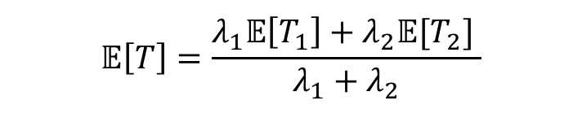








Bounding $𝔼[T]$ for MSR policies
Key Idea: decouple the system and analyze each job type separately
$λ_{1}+λ_{2}$ jobs/sec
Completion rate $=C(t)$
$λ_{1}$ jobs/sec
$$C_{1}(t)$$
$λ_{2}$ jobs/sec
$$C_{2}(t)$$
$$𝔼[T_{1}]$$
$$𝔼[T_{2}]$$
$$𝔼\left[T\right]=\frac{λ_{1}𝔼\left[T_{1}\right]+λ_{2}𝔼[T_{2}] }{λ_{1}+λ_{2}}$$
Notes:
TODO: record this slide
Now that we know when is the system stable, our next step is to bound the mean response time of an MSR policy.
The key idea here is that because how many type-1 jobs we are serving is independent from how many type-2 jobs in the system, we can decouple the system and analyze each job type separately.
Here we have a queue for all job types.
We can decouple it to type-1 queue and type-2 queue and analyze their mean response time separately before recomputing this weighted average to get our mean response time across all jobs.
General theorem statement here with proof sketches
Set up penalty from multiple jobs / variance first.
Multiresource scheduling is hard for two reasons
Running jobs in parallel
We are varying completion rates

Slide 18

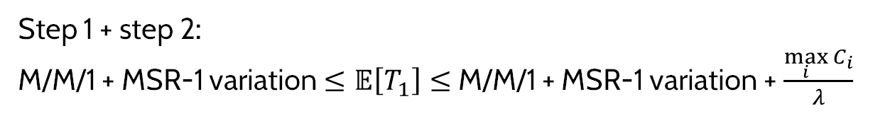










Multiresource Scheduling
MSR-1 (Grosof 2024)
Bounding $𝔼[T]$ for MSR policies
Type-1 completion rate: $C_{1}=3μ_{1}$
$${αx}_{1}$$
$λ_{1}$ jobs/sec
$${αx}_{2}$$
Step 1 (penalty from running multiple jobs)
Completion rate $=C_{1}(t)$
Type-1 completion rate: $C_{2}=0$
$λ_{1}$ jobs/sec
Varying completion rate $C_{1}(t)$
Step 2 (penalty from variance)
M/M/1 FCFS (Constant Service Rate)
$λ_{1}$ jobs/sec
Constant completion rate $μ_{1}^{∗}$
Step 1 + step 2:
M/M/1 + MSR-1 variation $≤𝔼\left[T_{1}\right]≤$ M/M/1 + MSR-1 variation + $\frac{\max_{i}{C_{i}}}{λ}$
Notes:
M/M/1 system that has the the same average completion rate, and takes one job at a time.
There are two differences here that we want to handle, we will take one at a time.
To handle running multiple jobs at a time, we will compare it to a system that runs one job at a time with the same modulating completion rate.
TODO: record this slide
Emphasize the two differences between multiresource vs M/M/1, and the difference between MSR-1 and multiresource system.
Next, we zoom into the type-1 queue to analyze its mean response time.
Works the same for other job types. 1. serve many jobs at a time, 2. switching completing rates
Jobs arrive into the type-1 queue with rate lambda_1 jobs/sec and the server completes the job at a variable rate according to the modulation process.
This system seems to be hard to analyze but we can relate it to some system we know how to analyze.
For example, we know how to analyze an M/M/1 system.
We can compare the original system to an M/M/1 system with Poisson arrival of rate lambda_1 and a constant completion rate mu_1^*.
Our insight here is that our multiresource system is not so different from an M/M/1 with the same average completion rate.
The constant completion rate here is the time average of the completion rates in the modulating process.
Fortunately, a recent work analyzes a system called MSR-1 by comparing to this M/M/1 system.
This MSR-1 system has the same arrival process but with varying completion rate according a similar Markov Chain.
The MSR-1 system takes one job at a time but it serves the job with varying rates.
When the multiresource system tries to serve two type-1 jobs, it is completing jobs at the rate of at most 2mu_1 jobs/sec because it may run slower when there is only one type-1 job in the queue.
If the MSR-1 system is in the corresponding state, it is always completing jobs at the rate of 2mu_1 jobs/sec.
Hence, the only difference between our system and the MSR-1 system is that we are completing jobs at a slower rate whenever there are not enough jobs in the system.
Effectively, we get a penalty from running jobs in parallel.
The MSR-1 system gets a penalty from varying the completion rates.
Combining those two penalty terms, we get the bounds on mean response time as the following.

Slide 19




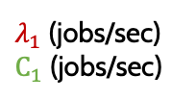





Evaluating the Bounds
$λ_{2}$ (jobs/sec)
$C_{2}$ (jobs/sec)
50
$$(0, 2)$$
40
Mean Response Time, $𝔼[T]$
30
$$s_{3}$$
$$(1, 1)$$
20
$$(3, 0)$$
$λ_{1}$ (jobs/sec)
$C_{1}$ (jobs/sec)
10
$$s_{2}$$
$$s_{1}$$
0.2
0.4
0.6
0.8
1.0
System load, $ρ$
Notes:
Rho<1 ⬄ stable
Sliding happens after the plot
We run simulations on this example to verify the effectiveness of our bounds. We will move this red dot, the arrival rate vector along this arrow, measure the mean response time across all jobs, and compare to our bounds.
On this plot, we have the system load rho on the x-axis, that is defined as how far we are from the border of the convex hull. The system load becomes 1 if we are on the boundry.
In other words, the system will become unstable if the load is larger than 1

Slide 20


Google Borg Evaluation
Google Borg: trace from Google data centers in 2019 (Tirmazi 2020).
80k
MaxWeight
Preemptive MSR
60k
Mean Response Time, $𝔼[T]$
40k
20k
.1
.3
.5
.7
.9
System load, $ρ$
Notes:
See full paper for details on proving constant-competitive
This trace violates our assumptions, so our theoretical proofs don’t hold.
Now that we know how to sconstruct an MSR policy given system parameters, we want to evaluate our constructed MSR policy in real world scenarios.
For example, Google released a trace in 2019 from their Borg scheduler.
First, let’s take a look at preemptive policies like MaxWeight and pMSR.
This is very encouraging at a higher level because we have designed a policy that is comparable with other policies while being simple to analyze and straightforward to implement.
The pMSR is performant at higher loads compared to MaxWeight, which is also a preemptive policy.
Next, we compare the nonpreemptive policies like BackFilling and nMSR.

Slide 21



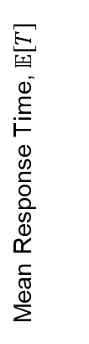



Conclusion
$${αx}_{1}$$
$${αx}_{2}$$
$$λ_{2}$$
$$C_{2}$$
$$s_{1}$$
$$s_{2}$$
Mean Response Time, $𝔼[T]$
$$μ^{∗}$$
$$s_{3}$$
$$λ_{1}$$
$$C_{1}$$
System load, $ρ$
Thank you!
Notes:
In conclusion, we first formalize the model of multiresource jobs.
Then, we show sufficient conditions for stability.
Next, we analyze mean response time for a given MSR policy.
Using those results, we show that picking a good MSR policy in the preemptive case means setting alpha to infinity.
Also, we show the tradeoff when picking alphas if the jobs are non-preemptible.

Slide 22
Questions?
$${αx}_{1}$$
$${αx}_{2}$$
$$λ_{2}$$
$$C_{2}$$
$$s_{1}$$
$$s_{2}$$
Mean Response Time, $𝔼[T]$
$$μ^{∗}$$
$$s_{3}$$
$$λ_{1}$$
$$C_{1}$$
System load, $ρ$
Thank you!
Notes:
In conclusion, we first formalize the model of multiresource jobs.
Then, we show sufficient conditions for stability.
Next, we analyze mean response time for a given MSR policy.
Using those results, we show that picking a good MSR policy in the preemptive case means setting alpha to infinity.
Also, we show the tradeoff when picking alphas if the jobs are non-preemptible.

Slide 23
Backup Slides

Slide 24

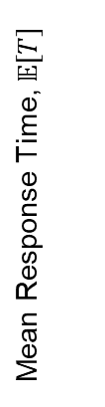
Google Borg Evaluation
nMSR
BackFilling
An Optimization: MSR with BackFilling
Select a schedule according to MSR and then inspect the jobs in FCFS order. Serve the job if it fits.
80k
MaxWeight
pMSR
60k
Mean Response Time, $𝔼[T]$
40k
pMSR with BackFilling
nMSR with BackFilling
20k
.01
.03
.05
.07
.09
System load, $ρ$
Notes:
Can we use the queue length information in a limited way to make these MSR with BackFilling policies better?

Slide 25



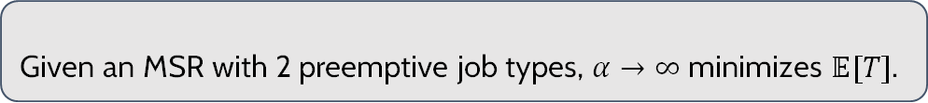

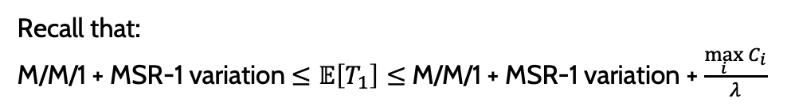
Picking the best pMSR policy
$$αx_{1}$$
$$αx_{2}$$
20
Recall that:
M/M/1 + MSR-1 variation $≤𝔼\left[T_{1}\right]≤$ M/M/1 + MSR-1 variation + $\frac{\max_{i}{C_{i}}}{λ}$
15
Mean Response Time, $𝔼[T]$
Our observation: As $α→∞$, MSR-1 variation $→0$.
10
Theorem 3 (Best MSR for Preemptible Jobs)
Given an MSR with 2 preemptive job types, $α→∞$ minimizes $𝔼[T]$.
5
.01
.03
.05
Switching rate, $α$
Notes:
Recall that we got our mean response time bounds that says that our response time is the M/M/1 plus the penalty from varying completion rates instead of a constant completion rate.
We prove that as alpha gets large, the variable completion rate system starts to behave like a constant rate system.
That is, this variation term goes to 0 as alpha -> infty.
We prove that setting alpha to infinity minimizes E[T] when there are 2 job types and we conjecture this holds for more job types.
We also evaluate this in simulation.
Here we have switching rate on the x axis and mean response time on the y axis.
As we increase the switching rate, we notice that the mean response time is consistently decreasing.
Therefore, to pick the a good MSR policy, we only need to construct a stable policy and then set alpha to infinity.

Slide 26
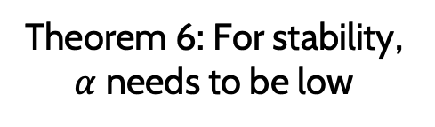



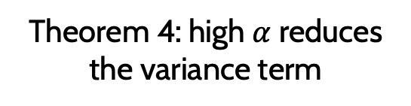
nMSR: Non-preemptive
150
Mean Response Time, $𝔼[T]$
100
50
$$α^{∗}$$
.01
.03
.05
Theorem 6: For stability, $α$ needs to be low
Switching rate, $α$
Theorem 4: high $α$ reduces the variance term
Tradeoff!!
Notes:
When picking an MSR with good response time under the non-preemptive setting, theorem 4 tells us we need set alpha to sufficiently low for stability.
However, theorem 3 from earlier tells us high alpha values reduce the variance term.
Therefore, there exists a tradeoff between picking alpha values.
In simulation, we show that setting alpha too low or too high will hurt mean response time.
In other words, we can find a reasonable rate of preemption alpha^* to minimize mean response time in this case.
In fact, we find that `we can use our response time analysis to find such alpha^* and it is within 1% difference from what we get in simulation.

