Slide 1
Improving Nonpreemptive Multiserver Job Scheduling with Quickswap
Zhongrui Chen¹, Adityo Anggraito³, Diletta Olliaro³, Andrea Marin³,
Marco Ajmone Marsan⁴, Benjamin Berg¹, Isaac Grosof²
¹University of North Carolina at Chapel Hill, ²Northwestern University,
³Università Ca’ Foscari Venezia, ⁴IMDEA Networks Institute,
IFIP Performance 2025
Jun 10, 2025

Slide 2




Data Centers Process Multiserver Jobs
Serverless
Containers
Data Analytics
Multiserver Jobs: Jobs that run on multiple servers simultaneously
Server needs: a job’s hard requirement for the number of servers needed
Question: how to schedule these workloads?

Slide 3
Multiserver Scheduling in Data Centers is Hard
Service duration: 3 seconds
(i) High server utilization: solving a binpacking problem
(ii) Stateful jobs: non-preemptible

Slide 4
Scheduling Policy
Response time, $T$
Job arrivals
A scheduling policy decides which jobs to run.
Schedule: jobs whose server needs don’t exist # servers.
Question: How to reduce mean response time, $𝔼\left[T\right]$?
Intuition: Design a policy with high server utilization.

Slide 5
Most Servers First (MSF)
Consider the jobs in descending server need order.
MSF tends to stay in the schedule it finds, unless:
(i) Running out of jobs of the same server need
(ii) Better schedule available

Slide 6
MSF under a Simplified Setting
One-or-all setting
Job arrivals
Light jobs
Heavy jobs
MSF serves jobs in alternating phases: heavy jobs phase and light jobs phase.

Slide 7
The Pitfalls of Most Servers First (MSF)
One-or-all setting
Job arrivals
MSF serves jobs in alternating phases: heavy jobs phase and light jobs phase.
Higher system load
Longer heavy jobs phase
Longer light jobs phase
Large average number of jobs in the system => Large $𝔼[T]$

Slide 8
Our Idea: MSF Quickswap (MSFQ)
One-or-all setting
Job arrivals
Serve light jobs until $ℓ$, a predefined threshold, remain.
Drain light jobs in service and switch to the heavy jobs phase.
Contribution 1: Develop and analyze MSF Quickswap (MSFQ)
Contribution 2: Generalize MSFQ outside of the one-or-all setting
Contribution 3: Evaluate the generalizations using real-world traces

Slide 9
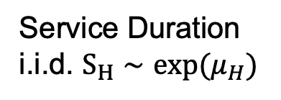
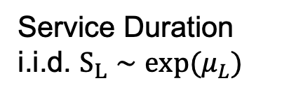



Our model
Service Duration
i.i.d. $S_{L}∼exp(μ_{L})$
Light jobs
$λ_{L}$jobs/sec
$K$servers
Heavy jobs
$λ_{H}$jobs/sec
Poisson Process
Service Duration
i.i.d. $S_{H}∼exp(μ_{H})$

Slide 10
Mean Response Time Analysis
$𝔼\left[T^{H}\right]≔$mean response time of a heavy job
$𝔼\left[T^{L}\right]≔$ mean response time of a light job
We can further condition $𝔼\left[T^{H}\right]$ and $𝔼\left[T^{L}\right]$.
Case 1: Job arrives when server is serving the same class of jobs

Slide 11
Mean Response Time Analysis
$𝔼\left[T^{H}\right]≔$mean response time of a heavy job
$𝔼\left[T^{L}\right]≔$ mean response time of a light job
We can further condition $𝔼\left[T^{H}\right]$ and $𝔼\left[T^{L}\right]$.
Case 1: Job arrives when server is serving the same class of jobs
Case 2: Job arrives when server is serving the other class of jobs

Slide 12
Case 1: Server is serving the same class of jobs
Response time for this arriving heavy job
= Total work of heavy jobs it sees + service duration
$N_{H}$: # heavy jobs starting this heavy phase

Slide 13



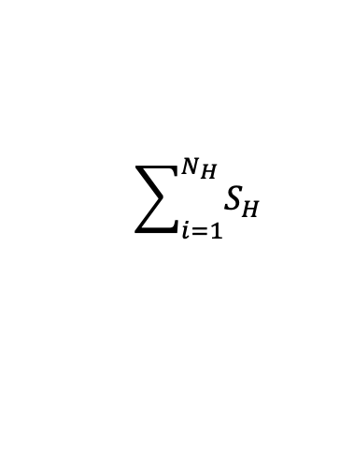
Case 1: Server is serving the same class of jobs
Response time for this arriving heavy job = Total work of heavy jobs it sees + service duration
$N_{H}$: # heavy jobs starting a heavy phase
Exceptional First Service (EFS) System
Exceptional service: Job sees empty system
$$\sum_{i=1}^{N_{H}}{S_{H}}$$
Poisson Process
$$λ_{H} jobs/s$$
Otherwise: Regular service
$$S_{H}$$

Slide 14

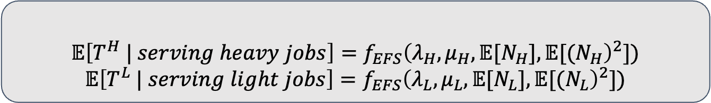

Case 1: Server is serving the same class of jobs
$N_{H}$: # heavy jobs starting a heavy phase
$N_{L}$: # light jobs starting a light phase
Theorem 1
$$𝔼\left[T^{H} | serving heavy jobs\right]=f_{EFS}{\left({λ_{H},μ}_{H},𝔼[N_{H}],𝔼[(N_{H}\right)}^{2}])$$
$$𝔼\left[T^{L} | serving light jobs\right]=f_{EFS}{\left({λ_{L},μ}_{L},𝔼[N_{L}],𝔼[(N_{L}\right)}^{2}])$$
Exceptional First Service (EFS) System
Exceptional service: Job sees empty system
$$\sum_{i=1}^{N_{H}}{S_{H}}$$
Poisson Process
$$λ_{H} jobs/s$$
Otherwise: Regular service
$$S_{H}$$

Slide 15
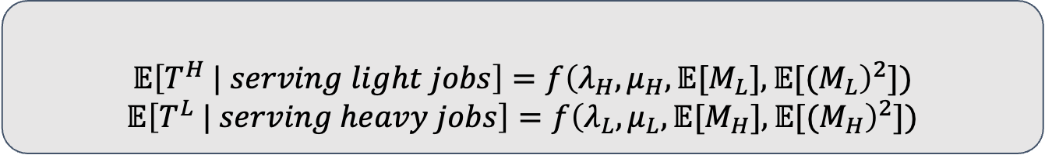



Case 2: Server is serving some other class of jobs
Job arrivals
A heavy job arrives seeing the server serving light jobs.
$M_{L}$: length of light phase
$M_{H}$: length of heavy phase
$𝔼\left[T^{H} | serving light jobs\right]=$ time before heavy phase starts
+ heavy arrivals before itself
+ time to serve itself
Theorem 2
$$𝔼\left[T^{H} | serving light jobs\right]=f{\left({λ_{H},μ}_{H},𝔼[M_{L}],𝔼[(M_{L}\right)}^{2}])$$
$$𝔼\left[T^{L} | serving heavy jobs\right]=f{\left(λ_{L},μ_{L},𝔼[M_{H}],𝔼[(M_{H}\right)}^{2}])$$

Slide 16


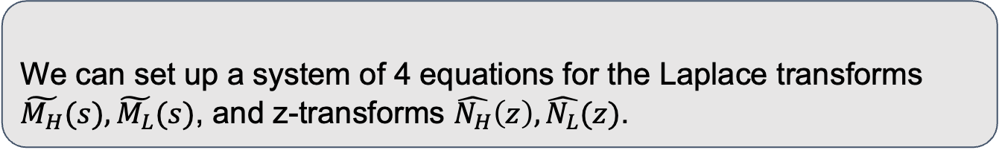


Solving for phase lengths
$𝔼\left[T\right]$: first two moments of phase length ($M_{H}, M_{L}$) and the # jobs starting each phase ($N_{H}, N_{L}$).
Larger $M_{H}$
Larger $N_{L}$
Larger $M_{L}$
Larger $N_{H}$
Theorem 3
We can set up a system of 4 equations for the Laplace transforms $\tilde{M_{H}}(s), \tilde{M_{L}}(s)$, and z-transforms $\hat{N_{H}}\left(z\right), \hat{N_{L}}(z)$.
To compute $𝔼\left[T\right]$, we only need to solve the first two derivatives of these transforms.
Calculator solving $𝔼\left[T\right]$ given parameters available on GitHub.

Slide 17


Comparing MSF and MSFQ
Simulation: $K=32$ where 90% light jobs and 10% heavy jobs, $μ_{L}=μ_{H}=1$. System load = 0.6.
MSF
50
40
Mean response time
30
Best MSFQ Threshold
20
10
5
10
15
20
25
30
MSFQ Threshold $ℓ$

Slide 18
Generalizations 1: Static Quickswap
Runs one job class until # falls below threshold.
Quickswap: drain this job class.
Serve the next job class.

Slide 19
Generalizations 2: Adaptive Quickswap
Admit jobs using MSF.
If jobs complete, admit jobs of the same class.
Run out of jobs? Drain all jobs in service.
Repeat.

Slide 20
Evaluation
Google Borg Cluster Scheduling trace
$K=2048$ servers, 26 jobs classes
Overall Mean Response Time
Weighted Mean Response Time
Every job is of equal weight
Jobs are weighted by their server needs
100000
MSF
Static Quickswap
80000
Adaptive Quickswap
60000
Weighted Mean response time
40000
20000
1
2
3
4
5
6
Arrival rate

Slide 21

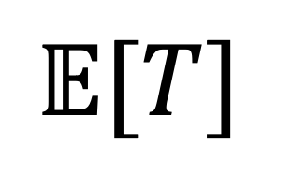

Conclusion
Longer heavy phase
Longer light phase
MSFQ ($ℓ$)
MSF
Static Quickswap
50
$$𝔼[T]$$
40
Adaptive Quickswap
Mean response time
30
20
10
5
10
15
20
25
30
MSFQ Threshold $ℓ$
Questions?

