Slide 1
Simple Policies for Multiresource Job Scheduling
Zhongrui (reads John-Ray) Chen¹, Isaac Grosof², Benjamin Berg¹
¹University of North Carolina at Chapel Hill, ²Northwestern University
INFORMS 2024
Oct 20, 2024

Slide 2
A Wide Variety of Workloads Run in Data Centers
Serverless
Cloud Instances (AWS, Azure, etc.)
High Performance Computing (HPC)
How to schedule these workloads?
Notes:
In practice, servers run multiple jobs of different workloads at the same time. However, they may not be able to serve all jobs at the same time because the servers may run out of resources. This raises the question of how to schedule these workloads, that is, which jobs should we run at every moment in time.

Slide 3
Why is data center scheduling hard?
Example: CPU and memory
Response time, $T$
Data centers serve jobs that request multiple resources --- multiresource jobs
CPUs
Memory
Storage (Local / Disaggregated)
Hardware Accelerator
Networks
Job arrivals
Does not fit
CPU
1 core
2G
1 core
1G
3 cores
1G
1 core
2G
0/4 cores
3/4 cores
4/4 cores
Memory
0/4 GBs
1/4 GBs
2/4 GBs
$K$ different types:
Type-1
Type-1
Type-2
Wastage!
How does wastage affect response time?
Notes:
Intuitively, more wastage leads to underutilization of some resources, eventually serving fewer jobs during some time period.
With some other scheduling policies, we may be able to utilize the server better.
Orange job will sit in the queue and wait because the server is running out of resources.

Slide 4
Our Multiresource Job Model
Type-1
$$S_{1}$$
Poisson($λ_{1}$)
Type-2
$$S_{2}$$
Poisson($λ_{2}$)
CPU
1 core
2G
1 core
2G
3 cores
1G
4/4 cores
Service requirement $S_{i}$:
time a type-$i$ job needs to be run on the server before completion.
$$S_{i}∼\exp{(μ_{i})}, i.i.d.$$
Memory
2/4 GBs
Type-1
Type-1
Type-2
Arrival rate vector $λ=\left(λ_{1},λ_{2},…,λ_{K}\right)$.
Goal:
Analyze the mean response time
Maximize the capacity region: set of conditions s.t. mean response time is bounded
Notes:
In the last case, if a job is being preempted, it stays in the server without getting service during its “setup time”. Then, it will be placed back into the queue waiting for service again.

Slide 5
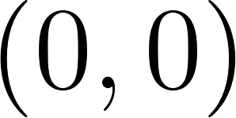
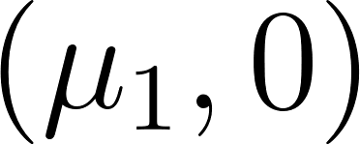
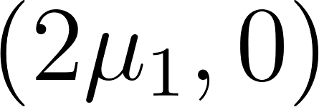
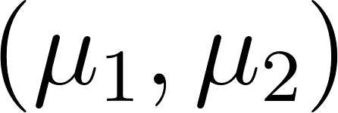
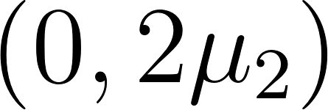
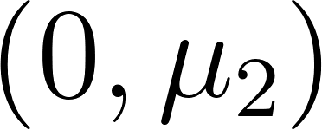
How do we pack jobs of each type to run on a server?
Feasible schedule respects the server capacity for every resource.
A scheduling policy determines a feasible schedule at every moment in time.
Instantaneous completion rate $C\left(t\right)=(C_{1}(t),C_{2}\left(t\right),…,C_{K}(t))$
$$C(t)$$
Example with 2 job types
0/4 cores
2/4 cores
4/4 cores
0/4 GBs
1/4 GBs
2/4 GBs
$$S_{1}$$
$$S_{2}$$
$$S_{1} \sim \exp\left(μ_{1}\right)$$
$$S_{2} \sim exp⁡(μ_{2})$$
Schedule 0: (0,0)
Schedule 1: (1,0)
Schedule 2: (2,0)
2 cores
1G
1 core
2G
Type-1 Jobs
Type-2 Jobs
3/4 cores
2/4 cores
1/4 cores
3/4 GBs
4/4 GBs
2/4 GBs
Schedule 3: (1,1)
Schedule 4: (0,2)
Schedule 5: (0,1)
We set $μ_{1}=μ_{2}=1$ to simplify the example
Notes:
Earlier, we talked about scheduling policies pick which jobs to run at every moment in time. Now that we have the model, we want to understand (title)
A feasible schedule is a set of jobs that can be run parallel and respects the all of the capacity constraints.
As we vary the schedule over time, we are tracking the completion rate of each job type…

Slide 6
Prior Works on Multiresource Scheduling
 | Maximizing Capacity Region | Simple | Response Time Analysis | Preemption
FCFS | No | Simple | Bounds [3] | Non-preemptive
MaxWeight [1] | Yes | Complex | Heavy traffic only | Preemptive
Randomized Timer [2] | Yes | Simple | No | Non-preemptive
Markovian Service Rate | Yes | Simple | Additively-tight bounds | General
Notes:
FCFS?

Slide 7
Prior Works on Multiresource Scheduling
 | Maximizing Capacity Region | Simple | Response Time Analysis | Preemption
FCFS | No | Simple | Bounds [3] | Non-preemptive
MaxWeight [1] | Yes | Complex | Heavy traffic only | Preemptive
Randomized Timer [2] | Yes | Simple | No | Non-preemptive
Markovian Service Rate | Yes | Simple | Additively-tight bounds | General
Overview:
Key Result 1: Conditions for stability of an MSR policy.
Key Result 2: Bounds on mean response time for an MSR.
Key Result 3: MSR under different preemption behaviors.
Notes:
The nice thing about MSR policies is that if there exists a policy that can stabilize the system, we have derive an MSR policy that can do so as well.
Now we want to show that MSR policies can get good mean response time. Therefore, we
We saw this FCFS example…
We saw this example that tries to maximize the number of jobs in service which is similar to what MaxWeight policy is doing…
(Overview)
First, I will more formally define this multiresource scheduling model…
By the end of this, you will be able to see that we are the first policy to do all 3.

Slide 8
Key Result 1: How can MSR stabilize a system?
$λ_{2}$(jobs/sec)
$λ_{2}$ (jobs/sec)
$C_{2}$ (jobs/sec)
$C_{2}$ (jobs/sec)
4/4 cores
2/4 GBs
Schedule 2: (2,0)
3/4 cores
Schedule 3 (1, 1)
Schedule 3
3/4 GBs
Schedule 3: (1,1)
(1.2, 0.2)
(1.2, 0.2)
Schedule 2 (2, 0)
Schedule 2
$λ_{1}$ (jobs/sec)
$λ_{1}$ (jobs/sec)
$C_{1}$ (jobs/sec)
$C_{1}$ (jobs/sec)
What if we only use schedule 2/3?
What if we switch between schedule 2 & 3?
Notes:
Show schedules after the plot

Slide 9
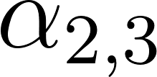
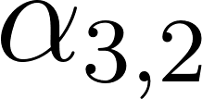
Our Idea: Modulated Service Rate (MSR) Policies
Schedule 2
Schedule 3
4/4 cores
3/4 cores
2/4 GBs
3/4 GBs
MSR uses a Continuous-Time-Markov-Chain to randomize the schedule at time $t$.
We call this CTMC the modulating process.
Long-run average completion rate $μ^{∗}$.
$$μ^{∗}=\lim_{t→∞}{\frac{1}{t}\int_{0}^{t}{C(x)dx}}$$
Theorem 1 (Stability conditions)
The system is stable when $μ^{∗}>λ$.
Notes:
We use a modulating process to switch among schedules because this is making it simple to analyze.

Slide 10
Key Result 1: Stability Conditions
$λ_{2}$ (jobs/sec)
$C_{2}$ (jobs/sec)
Theorem 1 (Stability conditions)
The system is stable when $μ^{∗}>λ$.
Schedule 3 (1, 1)
Average schedule $μ^{∗}$
$$λ=(1.2, 0.2)$$
Schedule 2 (2, 0)
$λ_{1}$ (jobs/sec)
$C_{1}$ (jobs/sec)
Notes:
Practice Describing average schedule

Slide 11
Key Result 2: Bounding $𝔼[T]$ for MSR policies
Key Idea: decouple the system and analyze each job type separately
$λ_{1}+λ_{2}$ jobs/sec
Completion rate $≤C_{1}(t)$
$λ_{1}$ jobs/sec
$λ_{2}$ jobs/sec
Completion rate $≤C_{1}(t)$
Completion rate $≤C_{2}(t)$
$$𝔼[T_{1}]$$
$$𝔼[T_{2}]$$
$$𝔼\left[T\right]=λ_{1}𝔼\left[T_{1}\right]+λ_{2}𝔼[T_{2}]$$
Notes:
General theorem statement here with proof sketches
Set up penalty from multiple jobs / variance first.
Multiresource scheduling is hard for two reasons
Running jobs in parallel
We are varying completion rates

Slide 12
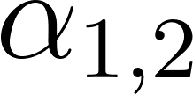
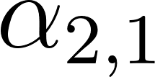
Multiresource Scheduling
MSR-1 (Grosof 2024)
Key Result 2: Bounding $𝔼[T]$ for MSR policies
Type-1 completion rate: $C_{1}=2μ_{1}$
$λ_{1}$ jobs/sec
4/4 cores
3/4 cores
2/4 GBs
3/4 GBs
Step 1 (penalty from running multiple jobs)
Completion rate $≤C_{1}(t)$
Type-1 completion rate: $C_{2}=μ_{1}$
$λ_{1}$ jobs/sec
Varying completion rate $C_{1}(t)$
$$C_{1}$$
1
2
$$C_{2}$$
Step 2 (penalty from variance)
M/M/1 FCFS (Constant Service Rate)
$λ_{1}$ jobs/sec
Constant completion rate $μ_{1}^{∗}$
Step 1 + step 2:
M/M/1 + MSR-1 variation $≤𝔼\left[T_{1}\right]≤$ M/M/1 + MSR-1 variation + $\frac{\max_{i}{C_{i}}}{λ}$
Notes:
General theorem statement here with proof sketches
Expand resource pooling: .
Set up penalty from multiple jobs / variance first.
Multiresource scheduling is hard for two reasons
Running jobs in parallel
We are varying completion rates

Slide 13
Key Idea 3: Preemption Behaviors

Slide 14
MSR Maximizes Capacity Region (Preemptible Jobs)
$λ_{2}$ (jobs/sec)
$C_{2}$ (jobs/sec)
Theorem 1 (Stability conditions)
The system is stable when $μ^{∗}>λ$.
Theorem 2 (Preemptive)
Given there are $K$ types of preemptible jobs. If there exists a policy that can stabilize the system, then there exists an MSR policy that can stabilize the system.
Schedule 3
Average schedule $μ^{∗}$
$$λ=(1.2, 0.2)$$
Schedule 2
$λ_{1}$ (jobs/sec)
$C_{1}$ (jobs/sec)
Convex hull of all feasible schedules
Notes:
Transition to next slide: how do we switch between schedules

Slide 15
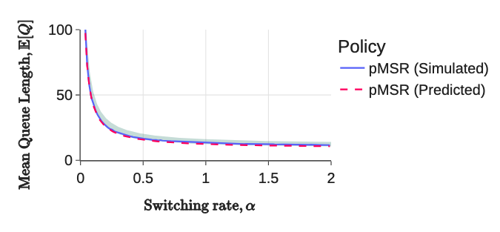
Picking the best MSR policy in the preemptive setting
$$α$$
$$C_{1}$$
1
2
$$C_{2}$$
$$α$$
Step 1 + step 2:
M/M/1 + MSR-1 variation $≤𝔼\left[T_{1}\right]≤$ M/M/1 + MSR-1 variation + $\frac{\max_{i}{C_{i}}}{λ}$
Theorem 3 (Best MSR for Preemptible Jobs)
Given an MSR with 2 preemptive job types, $α→∞$ minimizes $𝔼[T]$.
As $α→∞$, MSR-1 variation $→0$.
When jobs are preemptive, we set $α=∞$ to minimize $𝔼[T]$.
We prove that doing this minimizes $𝔼[T]$ switching between two configurations.
We conjecture that this holds for switching among more than two configurations.
Notes:
Animating the average schedule (move around)

Slide 16
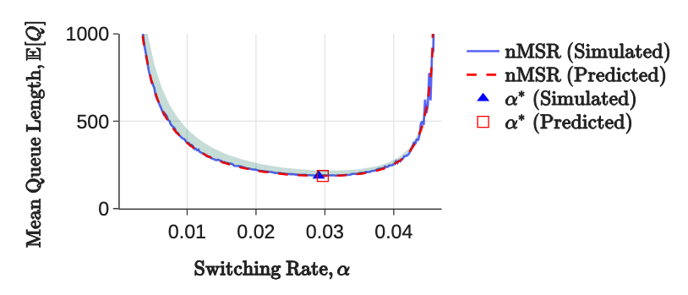
MSR: Non-preemptive
Key Result 1 still holds because we can set $α$ to a small value so that we almost never hit the switching states.
Stable but high $𝔼[T]$ due to slow switching
Unstable for spending too much time in switching states
$$α$$
$$0$$
$$∞$$
Notes:
Animating the average schedule (move around)

Slide 17
MSR: Non-preemptive
Key Result 1 still holds because we can set $α$ to a small value so that we almost never hit the switching states.
Stable but high $𝔼[T]$ due to slow switching
Unstable for spending too much time in switching states
$$α$$
$$0$$
$$∞$$
Notes:
Animating the average schedule (move around)

Slide 18
Minimizing the mean response time of MSR policies
$λ_{2}$ (jobs/sec)
$C_{2}$ (jobs/sec)
MSR Version 1: pick schedule 2 and schedule 3
MSR Version 2: pick schedule 2 and schedule 5
Schedule 5
Schedule 3
Average schedule
Average schedule
Schedule 2
Goal: Pick the MSR policy that minimizes $𝔼[T]$!
$λ_{1}$ (jobs/sec)
$C_{1}$ (jobs/sec)
An important observation: $\lim_{α_{1,2}+α_{2,1}→∞}𝔼\left[T_{1}^{MSR−1}\right]=$ M/M/1 response time
Heuristic: pick the the intersection between the arrival ray and the edge of the convex area.
Notes:
Animating the average schedule (move around)

Slide 19
How to find optimal MSR policy when preemptions are limited?
Average rate of preemption:
$$α=\frac{2α_{1,2}α_{2,1}}{α_{1,2}+α_{2,1}}$$
$$\min_{α_{1,2},α_{2,1}, C_{1},C_{2}}{𝔼[T]}$$
Subject to $α≤\overline{α},$
Where $\overline{α}$ denotes the preemption budget.
$𝔼\left[T_{1}^{MSR−1}\right]→$ switching penalty
$𝔼\left[T_{1}^{MSR−1}\right]→$ M/M/1
$$α$$
$$0$$
$$∞$$

Slide 20
An example on picking MSR
$λ_{2}$ (jobs/sec)
$C_{2}$ (jobs/sec)
Schedule 1
Schedule 3
Schedule 4
Schedule 2
$λ_{1}/C_{1}$ (jobs/sec)
Switching between 1 & 2: Low load, high variance
Switching between 3& 4: High load, low variance
Tradeoff between load and variance

Slide 21
Conclusion
Arrival / completion rates
MSR Policies
Average schedule
Arrival / completion rates
Arrival / completion rate of type-2 jobs
Bounds on $𝔼[T]$ for a given MSR Policy
Questions?
Schedule 1
Schedule 3
Schedule 4
Schedule 2
Arrival / completion rate of type-1 jobs

Slide 22
Backup Slides

Slide 23
Our Model of Multiresource Jobs
$$S_{3}$$
$$S_{2}$$
$$S_{2}$$
$$S_{2}$$
$$S_{1}$$
$$S_{1}$$
4 cores
2G
2 GPU
1024G
1 core
4G
0 GPU
0 G
1 core
4G
0 GPU
0 G
1 core
4G
0 GPU
0 G
2 cores
2G
1 GPU
256G
2 cores
2G
1 GPU
256G
256 cores
1024 GBs
$R$ Types of Resources
4 GPUs
…
128T SSD
Type-3 Job
Type-2 Job
Type-2 Job
Type-2 Job
Type-$1$ Job
Type-$1$ Job
$K$ Types of Jobs
Service requirement $S_{i}$: time a type-$i$ job needs to be run on the server before completion.
$$S_{i}∼\exp{(μ_{i})}, i.i.d.$$
Note: $S_{i}∼\exp\left(μ_{i}\right)$ means if we serve $n_{i}$ type-i jobs, we are completing the jobs at a rate of $n_{i}μ_{i}$ jobs/sec.
Notes:
Generalize from exponential to phase-type
Similar pictures to earlier ones

Slide 24
Arrivals
Stream of arriving jobs
$λ_{1}$ jobs/sec
$$S_{1}$$
Type-1 Jobs
$λ_{2}$ jobs/sec
$$S_{2}$$
Type-2 Jobs
Arrival rate vector $λ=\left(λ_{1},λ_{2},…,λ_{K}\right)$.

Slide 25
How do we pack jobs of each type to run on a server?
Feasible schedule respects the server capacity for every resource.
A scheduling policy determines a feasible schedule at every moment in time.
Instantaneous completion rate $C\left(t\right)=(C_{1}(t),C_{2}\left(t\right),…,C_{K}(t))$
Example with 2 job types
$$C(t)$$
$$S_{1}$$
$$S_{2}$$
$$S_{1} \sim \exp\left(μ_{1}\right)$$
$$S_{2} \sim exp⁡(μ_{2})$$
2 cores
1G
1 core
2G
0/4 cores
2/4 cores
4/4 cores
Type-1 Jobs
0/4 GBs
1/4 GBs
2/4 GBs
Type-2 Jobs
Schedule 0: (0,0)
Schedule 1: (1,0)
Schedule 2: (2,0)
Queue
Server Capacity
3/4 cores
2/4 cores
1/4 cores
4 cores
3/4 GBs
4/4 GBs
2/4 GBs
4 GBs
Schedule 3: (1,1)
Schedule 4: (0,2)
Schedule 5: (0,1)
We set $μ_{1}=μ_{2}=1$ to simplify the example
Notes:
Earlier, we talked about scheduling policies pick which jobs to run at every moment in time. Now that we have the model, we want to understand (title)
A feasible schedule is a set of jobs that can be run parallel and respects the all of the capacity constraints.
As we vary the schedule over time, we are tracking the completion rate of each job type…

Slide 26
Preemption Models
Job arrivals
CPU
1 core
1G
1 core
1G
3 cores
1G
4/4 cores
Memory
2/4 GBs
Jobs can be either:
In this talk: Preemptible (can be placed back into the queue immediately)
Non-preemptible (must finish service when running)
Preemptible with setup costs (can be placed back into the queue after a wait, during which the job does not receive service)
Notes:
In the last case, if a job is being preempted, it stays in the server without getting service during its “setup time”. Then, it will be placed back into the queue waiting for service again.

Slide 27
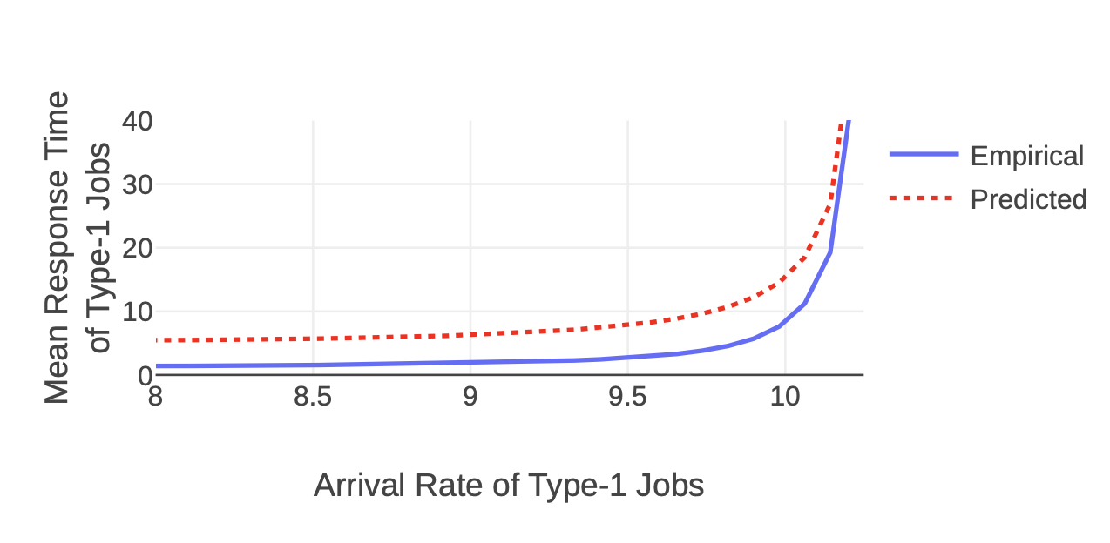
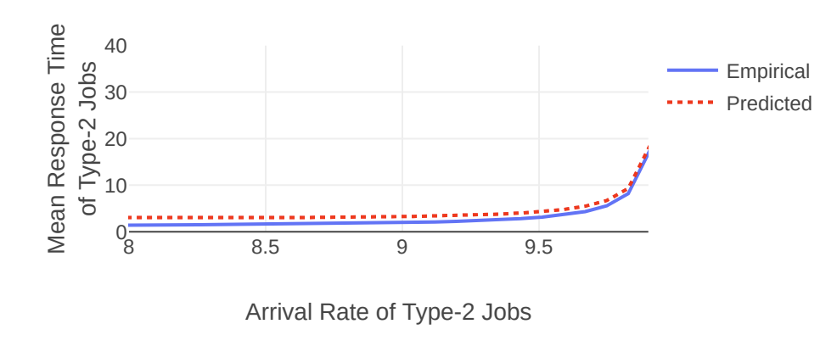
Simulation Results

Slide 28
Our Model of Multiresource Jobs
1G
256 cores
?G
2G
1024 GBs
1G
R Types of Resources
4 cores
1 core
…
? cores
$$S_{i}$$
$$S_{i}∼exp\left(μ_{i}\right), i.i.d.$$
…
2 cores
4 GPUs
128T SSD
Type-2 Job
Type-$K$ Job
…
Type-$i$ Job
Type-1 Job
$K$ Types of Jobs
Type-$i$ jobs share the same resource demands.
Type-$i$ jobs may have different service requirements.
Service requirement: time the job needs to be run on the server before completion.
Note that service requirements are unknown to the server.
We only know about the size distribution of type-$i$ jobs.
Note: $S_{i}∼\exp\left(μ_{i}\right)$ means if we serve $n_{i}$ type-i jobs, we are completing the jobs at a rate of $n_{i}μ_{i}$ jobs/sec.
Notes:
Generalize from exponential to phase-type
Similar pictures to earlier ones

Slide 29
Multiresource Jobs in Data Centers
Response time, $T$
Job arrivals
Question 1: $𝔼\left[T\right]$ bounded? Under what conditions?
Question 2: If so, can we minimize $𝔼\left[T\right]$?
Goal 1: Maximize stability region – set of conditions s.t. $𝔼\left[T\right]$ bounded.
Goal 2: Minimize mean response time, $𝔼\left[T\right]$.
Notes:
Our general goal is to minimize response time across jobs. However, response time may blow up to infinity under some conditions. For example, when the jobs are arriving at a rate much faster than the complete, the

Slide 30
Scheduling Multiresource Jobs
1G
Stream of arriving jobs
Completes and releases resources
4 cores
$λ_{1}$ jobs/sec
1G
$λ_{2}$ jobs/sec
1 core
$λ_{3}$ jobs/sec
CPU
3G
0/5 cores
2/5 cores
3/5 cores
5/5 cores
1 core
Memory
0/5 GBs
2/5 GBs
3/5 GBs
2/5 GBs
Reserves resources
2G
Scheduling policies chooses which jobs to run
Objective 1: Maximize stability region
Objective 2: Minimize $𝔼[T]$ — the mean response time
$λ_{4}$ jobs/sec
2 cores
Notes:
We consider the case where a stream of these jobs are arriving over time

Slide 31
How to schedule multiresource jobs?
How to maximize stability region?
How to minimize mean response time $𝔼[T]$?
Minimize Wastage
1G
3G
1G
1G
3G
2 cores
2 cores
4 cores
2 cores
5 cores
CPU
0/6 cores
5/6 cores
6/6 cores
Memory
0/6 GB
1/6 GB
6/6 GB
We first assume free preemptions are allowed.
Later: limited preemptions.

Slide 32
E[T] bounds
constant rate
penalty for switching
1
2
penalty for running jobs in parallel
where
and
An important observation:
What will happen if we limit the rate of preemption?
Notes:
Load => same as constant rate system
penalty for switching

Slide 33
Instantaneous Completion Rate and Stability
Plan here: introduce long-run completion rate $μ^{∗}$ and instantaneous completion rate $μ(t)$.
Argue that more wastage leads to smaller and $μ(t)$.
The system is stable when $μ^{∗}>λ$.
Because we want to sustain maximal arrival rate,
we want to reduce wastage and maximize $\hat{μ}$.
1G
Stream of arriving jobs
4 cores
$λ_{1}$ jobs/sec
1G
$λ_{2}$ jobs/sec
Completion rate
1 core
3G
$λ_{3}$ jobs/sec
1 core
2G
$λ_{4}$ jobs/sec
2 cores
Notes:
Let’s consider the case where wastage leads to a lower completion rate.

Slide 34
Foster-Lyapunov Theorem
Test Function
A measure of the system state — queue lengths.
We use L2 norm here.
Drift
Expected change in test function starting from a system state after some time t.
Theorem
If the drift is positive only for a finite number of states, then the system is stable.

Slide 35
How to schedule multiresource jobs?
First-Come-First-Served (FCFS)
Maximize Number of Jobs Running
Minimize Wastage
3 cores
4 cores
1G
Queue
2G
Latest arrival
Earliest arrival
3G
1 core
3/5 cores
4/5 cores
4/5 cores
0/5 cores
0/5 cores
3/5 cores
4/5 cores
5/5 cores
Preempt!
0/5 GBs
3/5 GBs
3/5 GBs
1/5 GBs
0/5 GBs
3/5 GBs
5/5 GBs
1/5 GBs
FCFS
Smarter Scheduler

Slide 36
How to schedule multiresource jobs?
First-Come-First-Served (FCFS)
Maximize Number of Jobs Running
Minimize Wastage
3 cores
4 cores
1G
Queue
2G
Latest arrival
Earliest arrival
3G
1 core
3/5 cores
4/5 cores
4/5 cores
0/5 cores
0/5 cores
3/5 cores
4/5 cores
5/5 cores
Preempt!
0/5 GBs
3/5 GBs
3/5 GBs
1/5 GBs
0/5 GBs
3/5 GBs
5/5 GBs
1/5 GBs
FCFS
Smarter Scheduler

Slide 37
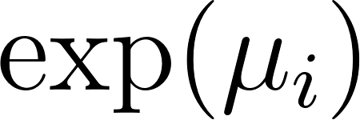
Our Model of Multiresource Jobs
for type-i jobs
1G
3G
Poisson arrival across same job type
1 core
…
1s
10s
4 cores
2s
1s
1G
2G
1 core
2 cores
Queue
Latest arrival
Earliest arrival
K Types of Jobs
256 cores
1024 GBs
i.i.d. sampled
R Types of Resources
4 GPUs
128T SSD
…
Type-1 Job
Type-2 Job
Type-3 Job
Type-4 Job
Type-i Job

Slide 38
Queueing Dynamics
We care about:
Capacity Region
Set of arrival rates such that the system is stable, which implies the mean queue length is finite.
Mean Response Time
Mean Response Time = Mean Queue Length / Arrival rate (Little’s Law)
Jobs arrive according to Poisson process
Scheduling algorithm selects jobs to serve and holds resources needed
Jobs complete and release the resources

Slide 39
Our Model of Multiresource Jobs
1G
256 cores
2G
1024 GBs
1G
3G
R Types of Resources
4 cores
1 core
1 core
2 cores
2 sec
i.i.d. sampled
4 GPUs
128T SSD
…
Type-1 Job
Type-2 Job
Type-3 Job
Type-4 Job
Type-i Job
We assume there are K types of jobs.
Type-i jobs share the same resource demands.
Each job has a service requirement — time to complete the job.

Slide 40
Our Ideas: Modulated Service Rate (MSR)
A set of algorithm that:
Uses a Continuous Time Markov Chain (CTMC) to modulate among pre-selected schedules.
0.1
Schedule 1
0.4
Schedule 2
0.1
0.2
10.0
Schedule 3
2.0

Slide 41
Theorem
If , then the system is stable under MSR.
The converse is easy to show, since there will be more jobs arriving than departing that will blow the queue lengths up.

Slide 42
Proof Sketch
When queues are long, drift is negative following from the assumption .
When queues are short, we can show that those cases are finite.

Slide 43
MSR is throughput-optimal
By [1], if an algorithm can stabilize the system when , then the algorithm is throughput-optimal.
Remember the converse of the theorem implies no algorithm can stabilize such arrival rates.
[1] Siva Theja Maguluri and Rayadurgam Srikant. 2013. Scheduling jobs with unknown duration in clouds. IEEE/ACM Transactions On Networking 22, 6 (2013), 1938–1951.

Slide 44
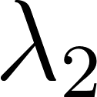
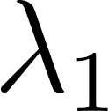
Our Ideas: Modulated Service Rate (MSR)
Known arrival rate
Completion rates from feasible schedules
Average Completion rate by modulating among schedules
If completion rate > arrival rate for each dimension, then the queue length is bounded. We say the system is stable in this case.
Throughput vs mean response time: throughput here is defined as the set of all arrival vectors such that the system is stable under a scheduling policy. We will show that MSR achieves maximal throughput while having good mean response time.
Notes:
No single feasible schedule yields stability =>
Combination of feasible schedules

Slide 45
Our Ideas: Modulated Service Rate (MSR)
Known arrival rate
Completion rates from feasible schedules
Average Completion rate by modulating among schedules
Our main theorem: The system is stable if the average completion rate is larger than arrival rate for each dimension.
Our main theorem: The system is stable if the average potential completion rate is larger than arrival rate for each dimension.
2/4 cores
4/4 GBs
Schedule: (0,2)
Note: The actual completion rate may be lower when there are not enough jobs in the queue.

Slide 46
Our Ideas: Modulated Service Rate (MSR)
Now that we have shown we can pick only K schedules to stabilize the system, we need to specify which schedule to pick at time t.
We use a Continuous-Time-Markov-Chain (CTMC) as a stochastic process to randomize the schedule at time t.
Schedule 1
Schedule 2
Schedule 3

Slide 47
Example: Solve for Average Completion Rate
Solving the CTMC on the left, we know that we are in schedule (0, 2) half of the time and (2, 0) half of the time.
1
(2, 0)
(0, 2)
1
Then, the time average schedule would be
0.5 (0, 2) + 0.5 (2, 0) = (1, 1).
The average completion rate would be .
As long as average completion rate > arrival rate, the system is stable.

Slide 48
Picking the Candidate Set
Theorem: If the given arrival vector can be stabilized, there exists a CTMC with at most K states that can stabilize the system.
This follows from Carathéodory Theorem.
Now, we have shown that MSR can stabilize all arrival rates if possible — that is, MSR achieves maximal throughput. We next show that we can analyze mean response time given the arrival rates and MSR CTMC.

Slide 49
Using MSR-1 to bound MSR
Recall that the MSR algorithm selects the schedule according to the following CTMC.
If we only look at a single resource, the mean queue length is the same as the MSR-1 system.
0.1
Schedule 1
0.4
Schedule 2
0.1
0.2
10.0
Schedule 3
2.0

Slide 50
Does an MSR policy with bounded mean response time exist?
Recall that the mean response time is bounded when time-average completion rate is larger than arrival rate.
Arrival / completion rate of type-2 jobs
It exists if the arrival rate is in the convex hull of all schedules.
Schedule 3
Moreover, if the arrival vector is given, we can pick K (number of job types) schedules so that the arrival vector lies within the convex hull of these K schedules.
Time-average schedule
Schedule 2
Arrival / completion rate of type-1 jobs
Notes:
many possible ways to pick the schedules – shaded area

Slide 51
Does a simple policy exist?
MaxWeight is a scheduling policy that achieves bounded mean response time for every possible arrival rate vector.
The catch: we need to solve a complex optimization problem at each step.
The complexity of MSR algorithms depends on the number of schedules.
If the arrival rates are given, we can pick only K schedules, giving us a simple policy.

Slide 52
How to pick an MSR policy?
Lower mean response time!
To compare MSR policies, we need a way to analyze their mean response times.
Minimizing mean response time ⇔ Minimizing mean queue lengths.
We decompose the multiserver job model to K different systems, and compare each to a system we know how to analyze.

Slide 53
How to minimize the mean queue lengths of type-i jobs?
We derive bounds on the mean queue lengths.
We compare the mean queue length of type-i job to MSR-1 systems.

Slide 54
MSR-1 Systems vs Multiserver Job Systems
Queue
Server Capacity
4 cores
4 GBs
0.5
1
2
Schedule 2
Schedule 3
Server runs at 1x the speed
Server runs at 2x the speed
1.5
Schedule 4

Slide 55
Our Approach vs Prior Work
We achieve all at the same time:
Low Complexity
Analyzable Response Time
Maximum Throughput

Slide 56
Why is it hard?
Each job occupies the entire server
Arrivals
Traditional queueing-theoretic models
Wastage
Jobs complete
Server (busy)
Server (idle)
1G
3G
1 core
wastage
4 cores
3/4 cores
Jobs (VMs / Applications)
1G
2G
VM Hosts / Server
1 core
3/4 GBs
2 cores

Slide 57
Model Assumptions
Server Capacity can be (256 cores, 256G memory, 1TB disk, …)
types of jobs. Jobs of the same type share the same resource demands.
Service requirement: the time it takes to complete a job.
Service requirements of type-i jobs are sampled i.i.d. from an exponential distribution .
Arrival process of type-i jobs follows .
Type-1 Job: (128 cores, 128G memory)
Server Capacity
256 cores
A server that runs 2 type-1 jobs and 4 type-2 jobs
Type-2 Job: (64 cores, 128G memory)
256G memory

Slide 58
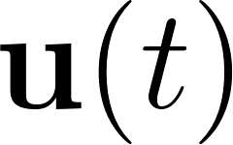
Schedules
How many jobs of each type are put into service.
If the server can serve all jobs in the schedule at time same time, we call this schedule a feasible schedule.
denotes the schedule at time t.
Type-1 Job: (128 cores, 128G memory)
Examples of Feasible Schedules
Schedule: (2 Type-1 Jobs, 4 Type-2 Jobs)
Schedule: (3 Type-1 Jobs, 1 Type-2 Job)
Type-2 Job: (64 cores, 128G memory)

Slide 59
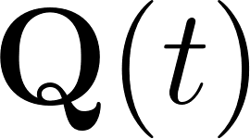
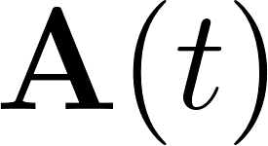
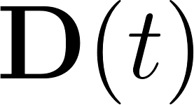
Queueing Dynamics
— the number of jobs of each type in queue.
— queue lengths at time t.
— cumulative arrivals of each type up to time t.
— cumulative departures of each type up to time t.
Type-1 Job: (128 cores, 128G memory)
Type-2 Job: (64 cores, 128G memory)

Slide 60
More on Queueing Dynamics
Let .
because of Poisson arrivals.

Slide 61
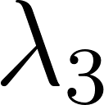
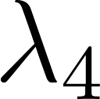
Another perspective of the queue
Given wastage, when is completion rate > arrival rate?
jobs/sec
Completion rate of type-1 jobs
Key Difference:
Jobs in our model follow different distributions.
Queue for type-1 jobs
All queues are stable => The system is stable.
jobs/sec
Completion rate of type-2 jobs
Queue for type-2 jobs
When stable, throughput == arrival rate
jobs/sec
Completion rate of type-3 jobs
What does it mean by maximizing throughput?
Queue for type-3 jobs
A: Make more arrival rates stable.
Note: throughput here is the set of all arrival rates such that the system is stable.
Completion rate of type-4 jobs
jobs/sec
Queue for type-4 jobs
Notes:
When the system is stable, throughput equals to the completion rate because:
There are only this many jobs arriving at the system
The queue is bounded

Slide 62
Performance Metrics
Mean Response Time (Latency)
Throughput: The set of arrival rates s.t. the system is stable.
Some Ideas on scheduling Multiresource Jobs:
FCFS (First-Come-First-Served)
Minimize Wastage
Maximize # Jobs in Service

Slide 63
State-of-the-art Multiresource Scheduling Policy
MaxWeight Policy (Maguluri 2013): Maximize weighted # of jobs in service
😊 Maximizes throughput
😊 Good response time performance
😢 Solves a bin-packing problem continuously
😢 Response time too complex to analyze
Randomized Timer (Ghaderi 2016):
😊 Maximizes throughput
😊 Simple policy
😢 Bad response time performance
😢 Response time too complex to analyze
Our result: Response time analysis on simple and throughput-optimal policies

