Slide 1
Simple Policies for Multiresource Job Scheduling
Zhongrui (reads John-Ray) Chen¹, Isaac Grosof², Benjamin Berg¹
¹University of North Carolina at Chapel Hill, ²Northwestern University
INFORMS 2024
Oct 20, 2024

Slide 2
A Wide Variety of Workloads Run in Data Centers
Serverless
Cloud Instances (AWS, Azure, etc.)
High Performance Computing (HPC)
How to schedule these workloads?
Notes:
In general, a wide variety of workloads like serverless applications, cloud instances and HPC runs in data centers.
However, these workloads have very different resource demands – as some are CPU-intensive, some are memory-intensive and some are disk-intensive.
In order to run a set of these jobs in parallel, a host server needs to have enough resources for all these jobs.
This raises the question of how can we schedule these workloads, that is, which jobs do we choose to run at every moment in time.

Slide 3
Why is data center scheduling hard?
Example: CPU and memory
Data centers serve jobs that request multiple resources --- multiresource jobs
CPUs
Memory
Storage (Local / Disaggregated)
Hardware Accelerator
Networks
Job arrivals
Does not fit
CPU
1 core
2G
1 core
2G
3 cores
1G
4/4 cores
0/4 cores
3/4 cores
Memory
3/4 GBs
0/4 GBs
1/4 GBs
Wastage!
Must find allocations with low wastage!
Notes:
To get started, we first show that data center scheduling is hard.
Typically, data centers serves multiresource jobs that requests some CPU cores, some memory, some storage, hardware accelerations and even networks resources.
In this simple example where we only have CPU and memory, we assume the server has 4 cores of CPUs and 4 Gigs of RAM.
There may be some multiresource jobs arriving into the queue.
For instance, when this blue job and orange job arrives, we can serve those two jobs simultaneously because the server has enough resources.
When another orange job arrives, the server runs out of CPU cores therefore the job needs to sit in the queue and wait to be served.
After some time, the first orange job may complete and leave the system, therefore we can serve the blue job and the later arriving orange job in parallel.
(added) Note that we are idling 1Gig of memory by serving these two jobs.
This complicates the scheduling problem because the wastage makes the system not work-conserving.
In order to get the most out of the system, we need to limit the wastage by finding better allocations.
However, this is hard because minimizing wastage requires solving a complex binpacking problem continuously.
TODO:
Remove green jobs.
Out of CPU cores so it cannot run.
Intuitively, more wastage leads to underutilization of some resources, eventually serving fewer jobs during some time period.
With some other scheduling policies, we may be able to utilize the server better.
Orange job will sit in the queue and wait because the server is running out of resources.

Slide 4
Our Multiresource Job Model
Response time, $T$
Type-1
$$S_{1}$$
Poisson($λ_{1}$)
Type-2
$$S_{2}$$
Poisson($λ_{2}$)
CPU
1 core
2G
1 core
2G
3 cores
1G
4/4 cores
Memory
Service requirement $S_{i}$:
time a type-$i$ job needs to be run on the server before completion.
$$S_{i}∼\exp{(μ_{i})}, i.i.d.$$
3/4 GBs
Type-1
Type-1
Type-2
We assume there are $K$ types of jobs.
Goal:
Maximize the stability region: set of cases s.t. mean response time is bounded.
Analyze the mean response time, $𝔼[T]$.
Notes:
In our multiresource job model, we care about this response time T, which is the time from when as job arrives until it completes.
Note that the orange jobs share the same resource demands, hence we group the jobs into types by resource demands.
We assume that there are K types of jobs in the system.
We assume type-I jobs arrive according to a Poisson process with rate lambda_i.
We also define the service requirements of type-I jobs as S_i, which is (repeat).
We assume this is i.i.d. exponentially distributed with rate mu_i.
Earlier, we said the system has wastage, therefore it is not work conversing.
In this case, it is hard to even characterize the stability region, which is the set of cases such that mean response time is bounded.
The stability region depends on how wasteful we are on resources.
Hence, our goal is to design a policy that reduces wastage to maximize the stability region while giving analyasis on its mean response time E[T].

Slide 5
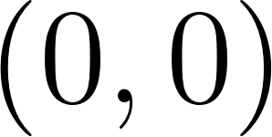
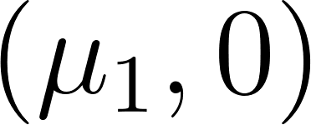
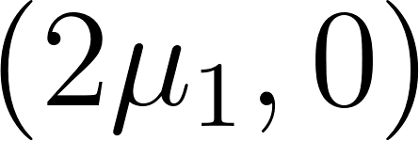
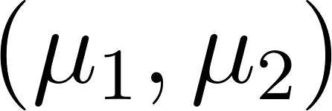
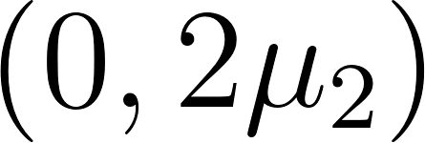
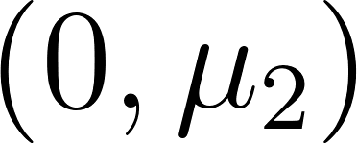
How do we pack jobs of each type to run on a server?
Feasible schedule respects the server capacity for every resource.
A scheduling policy determines a feasible schedule at every moment in time.
Instantaneous completion rate $C\left(t\right)=(C_{1}(t),C_{2}\left(t\right),…,C_{K}(t))$
$$C(t)$$
Example with 2 job types
0/4 cores
2/4 cores
4/4 cores
0/4 GBs
1/4 GBs
2/4 GBs
$$S_{1}$$
$$S_{2}$$
$$S_{1} \sim \exp\left(μ_{1}\right)$$
$$S_{2} \sim exp⁡(μ_{2})$$
Schedule 0: (0,0)
Schedule 1: (1,0)
Schedule 2: (2,0)
2 cores
1G
1 core
2G
Type-1 Jobs
Type-2 Jobs
3/4 cores
2/4 cores
1/4 cores
3/4 GBs
4/4 GBs
2/4 GBs
Schedule 3: (1,1)
Schedule 4: (0,2)
Schedule 5: (0,1)
We set $μ_{1}=μ_{2}=1$ to simplify the example
Notes:
To begin with, we need to understand what are the possible packings on a server.
We define a feasible schedule as a set of jobs that can run in parallel because they respect the server capacity for every resource.
Then, a scheduling policy determines a feasible schedule at every moment in time.
In this simple example where we only have two job types, we assume our server has 4 cores and 4Gigs of RAM.
Hence, here are all the feasible schedules.
As we vary the schedule over time, we can keep track of an instantaneous completion rate, that is how fast are we completing each type of jobs. If we take a look at schedule two, we shall see that when we choose to serve two type-1 jobs in parallel, they complete at a rate of 2 times mu_1 jobs per second.

Slide 6
Prior Works on Multiresource Scheduling
FCFS [Grosof 2024]: poor stability region
MaxWeight [Maguluri 2013]: complex, preempts frequently
Randomized Timers [Ghaderi 2016]: poor response time, no response time analysis
Our Solution: Markovian Service Rate (MSR) Policy
Computationally Simple
Max Stability
Response Time Analysis
Preemptive or Non-preemptive
Key Result 1
Key Result 2
Key Result 3
Notes:
There are some previous attempts tackling the multiresource scheduling problem.
First, we tried a simple policy like First-Come-First-Serve, a policy that continuously admits the jobs until we are out of resources.
While this simple policy is easy to implement, it’s not doing anything to find a better allocation.
This results in a poor stability region. Only recently we start to understand its mean response time.
MaxWeight tries to find a better allocation by solving a binpacking problem to minimize the wastage every time there’s an arrival or completion, but this is computationally complex.
Furthermore, it needs to preempt the jobs frequently to vary the schedule.
To try to address these problems with MaxWeight, people developed this randomized Timers policy that tries to find the packings like MaxWeight does, without the computational complexity and preemptions.
However, this policy is too complex to analyze, and emits poor response time.
We develop a class of policy called Markovian Service Rate policy that is computationally simple,
Provides maximal stability region,
Gives bounds on mean response time,
And handles cases where jobs are either preemptive or non-preemptive.
For the rest of the talk, we will show three key results.
Firstly, we show the sufficient conditions for stability, which will later be used to show maximal stability for the class of MSR.
Secondly, we analyze the mean response time of a given MSR policy.
Thirdly, we show that the class of MSR policy can handle preemptive and non-preemptive jobs and we show how to design an MSR to stabilize the system whenever it is possible to do so and at the same time minimize the mean response time within the class of MSR.

Slide 7
Key Result 1: Stability Conditions
Arrival rate vector $λ=\left(λ_{1},λ_{2},…,λ_{K}\right)$.
Example: $λ=(1.2, 0.2)$.
$λ_{2}$(jobs/sec)
$λ_{2}$ (jobs/sec)
$C_{2}$ (jobs/sec)
$C_{2}$ (jobs/sec)
4/4 cores
2/4 GBs
Schedule 2: (2,0)
3/4 cores
Schedule 3 (1, 1)
Schedule 3
3/4 GBs
Schedule 3: (1,1)
$$λ=(1.2, 0.2)$$
$$λ=(1.2, 0.2)$$
Schedule 2 (2, 0)
Schedule 2
$λ_{1}$ (jobs/sec)
$λ_{1}$ (jobs/sec)
$C_{1}$ (jobs/sec)
$C_{1}$ (jobs/sec)
Notes:
We first define arrival rate vector as follows.
(axis)
Then, as an example, we let type-1 jobs arrive at a rate of 1.2 jobs/sec and type-2 jobs arrive at a rate of 0.2 jobs/sec.
Here we plot its arrival rate vector on the left.
On the right, we plot the instantaneous completion rates for some of the feasible schedules.
(expand merging)
Intuitively, jobs need to complete faster than they arrive, therefore we want to merge the two plots and compare the rates.

Slide 8
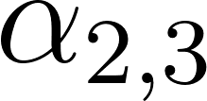
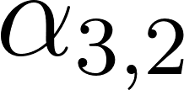
Stability Conditions and Our Solution
$λ_{2}$ (jobs/sec)
$C_{2}$ (jobs/sec)
Long-run average completion rate $μ^{∗}$.
$$μ^{∗}=\lim_{t→∞}{\frac{1}{t}\int_{0}^{t}{C(x)dx}}$$
Theorem 1 (Stability conditions)
The system is stable when $μ^{∗}>λ$.
Schedule 3 (1, 1)
Average schedule $μ^{∗}$
$$λ=(1.2, 0.2)$$
Schedule 2
Schedule 3
Schedule 2 (2, 0)
4/4 cores
3/4 cores
$λ_{1}$ (jobs/sec)
$C_{1}$ (jobs/sec)
2/4 GBs
3/4 GBs
Markovian Service Rate (MSR) Policies:
MSR uses a Continuous-Time-Markov-Chain to randomize the schedule at time $t$.
We call this CTMC the modulating process.
Notes:
As we vary the schedule over time, we can compute the long-run average completion rate mu^* as follows.
We develop a theorem that says the system is stable whenever mu^*>lambda following a Lyapunov drift style argument.
This implies that the average schedule must lie in this shaded area to stabilize the system.
Unfortunately, neither schedule 2 nor schedule 3 lies in this cone, hence we cannot always run schedule 2 or 3.
We can’t just pick one schedule and use it at all times.
(average schedule)
Instead, to achieve this average schedule, our idea is to randomize the schedule with this Continuous Time Markov Chain, which we call the modulating process.
By setting transition rates in the CTMC carefully, we can make this average schedule lie inside the cone.
We have to have some policy that switches between schedule 2 & 3 in order to get an average schedule that lies in the cone.

Slide 9
Key Result 2: Bounding $𝔼[T]$ for MSR policies
Key Idea: decouple the system and analyze each job type separately
$λ_{1}+λ_{2}$ jobs/sec
Completion rate $≤C_{1}(t)$
$λ_{1}$ jobs/sec
$λ_{2}$ jobs/sec
Completion rate $≤C_{1}(t)$
Completion rate $≤C_{2}(t)$
$$𝔼[T_{1}]$$
$$𝔼[T_{2}]$$
$$𝔼\left[T\right]=\frac{λ_{1}𝔼\left[T_{1}\right]+λ_{2}𝔼[T_{2}] }{λ_{1}+λ_{2}}$$
Notes:
Now that we know when is the system stable, our next step is to bound the mean response time of an MSR policy.
The key idea here is that because how many type-1 jobs we are serving is independent from how many type-2 jobs in the system, we can decouple the system and analyze each job type separately.
Completion rates only depends on the evolution of the CTMC, not on the queue lengths of other jobs.
Here we have a queue for all job types.
We can decouple it to type-1 queue and type-2 queue and analyze their mean response time separately before recomputing this weighted average to get our mean response time across all jobs.
General theorem statement here with proof sketches
Set up penalty from multiple jobs / variance first.
Multiresource scheduling is hard for two reasons
Running jobs in parallel
We are varying completion rates

Slide 10
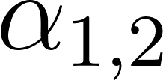
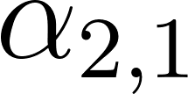
Multiresource Scheduling
MSR-1 (Grosof 2024)
Key Result 2: Bounding $𝔼[T]$ for MSR policies
Type-1 completion rate: $C_{1}=2μ_{1}$
$λ_{1}$ jobs/sec
4/4 cores
3/4 cores
2/4 GBs
3/4 GBs
Step 1 (penalty from running multiple jobs)
Completion rate $≤C_{1}(t)$
Type-1 completion rate: $C_{2}=μ_{1}$
$λ_{1}$ jobs/sec
Varying completion rate $C_{1}(t)$
$$C_{1}$$
1
2
$$C_{2}$$
Step 2 (penalty from variance)
M/M/1 FCFS (Constant Service Rate)
$λ_{1}$ jobs/sec
Constant completion rate $μ_{1}^{∗}$
Step 1 + step 2:
M/M/1 + MSR-1 variation $≤𝔼\left[T_{1}\right]≤$ M/M/1 + MSR-1 variation + $\frac{\max_{i}{C_{i}}}{λ}$
Notes:
Next, we zoom into the type-1 queue to analyze its mean response time.
Jobs arrive into the type-1 queue with rate lambda_1 jobs/sec and the server completes the job at a variable rate according to the modulation process.
This system seems to be hard to analyze but we can relate it to some system we know how to analyze.
For example, we know how to analyze an M/M/1 system.
We can compare the original system to an M/M/1 system with Poisson arrival of rate lambda_1 and a constant completion rate mu_1^*.
Our insight here is that our multiresource system is not so different from an M/M/1 with the same average completion rate.
The constant completion rate here is the time average of the completion rates in the modulating process.
Fortunately, a recent work analyzes a system called MSR-1 by comparing to this M/M/1 system.
This MSR-1 system has the same arrival process but with varying completion rate according a similar Markov Chain.
The MSR-1 system takes one job at a time but it serves the job with varying rates.
When the multiresource system tries to serve two type-1 jobs, it is completing jobs at the rate of at most 2mu_1 jobs/sec because it may run slower when there is only one type-1 job in the queue.
If the MSR-1 system is in the corresponding state, it is always completing jobs at the rate of 2mu_1 jobs/sec.
Hence, the only difference between our system and the MSR-1 system is that we are completing jobs at a slower rate whenever there are not enough jobs in the system.
Effectively, we get a penalty from running jobs in parallel.
The MSR-1 system gets a penalty from varying the completion rates.
Combining those two penalty terms, we get the bounds on mean response time as the following.

Slide 11
Key Idea 3: Preemption Behaviors
Notes:
Now that we know when the system is stable and how to analyze the mean response time of an MSR, we move on and talk about how MSR works under different preemption models. That is, how to find a MSR policy that is stable and has good mean response time when jobs are preemptible or non-preemptible.

Slide 12
MSR Maximizes Stability Region (Preemptible Jobs)
$λ_{2}$ (jobs/sec)
$C_{2}$ (jobs/sec)
Theorem 1 (Stability conditions)
The system is stable when $μ^{∗}>λ$.
Theorem 2 (Preemptive)
Given preemptible jobs, if there exists a policy that can stabilize the system, some MSR policy can stabilize the system.
Schedule 3
Average schedule $μ^{∗}$
$$λ=(1.2, 0.2)$$
Schedule 2
$λ_{1}$ (jobs/sec)
$C_{1}$ (jobs/sec)
Schedule 2
$$αx_{1}$$
Schedule 3
4/4 cores
3/4 cores
Convex hull [Maguluri 2013] of all feasible schedules
2/4 GBs
3/4 GBs
$$αx_{2}$$
Notes:
First, let’s investigate the case where jobs are preemptible.
We know from earlier that the system is stable whenever mu^*>lambda.
We can therefore show that whenever possible, there exists an MSR policy that can stabilize the system.
Here is our constructive proof.
From Maguluri 2013, lambda has to be in this convex hull of the feasible schedules in order to stabilize the system.
Maguluri tells us that the convex hull of all feasible schedules is the maximal stability region of the system.
(Added) Intuitively this makes sense by theorem 1 because this is the set of points where we can find a set of schedules such that the mu^* is larger than lambda.
By the definition of convex hull, if lambda lies in the interior, then we can find a larger mu^* by taking the intersection between the arrival vector and the edge of the convex hull.
Then, we modulate among the corresponding feasible schedules and set the transition rates such that mu^* gets to this average.
Note that there is an alpha in the transition rates because the stationary distribution does not change when we vary alpha.
Consequently, we can set alpha to whatever value we want without moving mu^*.
This is saying that we can choose to preempt however frequent we want.

Slide 13
Picking the best MSR policy in the preemptive setting
Schedule 2
$$αx_{1}$$
Schedule 3
4/4 cores
3/4 cores
2/4 GBs
3/4 GBs
$$αx_{2}$$
Recall that: M/M/1 + MSR-1 variation $≤𝔼\left[T_{1}\right]≤$ M/M/1 + MSR-1 variation + $\frac{\max_{i}{C_{i}}}{λ}$
Our observation: As $α→∞$, MSR-1 variation $→0$.
20
Theorem 3 (Best MSR for Preemptible Jobs)
Given an MSR with 2 preemptive job types, $α→∞$ minimizes $𝔼[T]$.
15
Mean Response Time, $𝔼[T]$
10
5
.01
.03
.05
Switching rate, $α$
Notes:
Recall that we got our mean response time bounds that says that our response time is the M/M/1 plus the penalty from varying completion rates instead of a constant completion rate.
We prove that as alpha gets large, the variable completion rate system starts to behave like a constant rate system.
That is, this variation term goes to 0 as alpha -> infty.
We prove that setting alpha to infinity minimizes E[T] when there are 2 job types and we conjecture this holds for more job types.
We also evaluate this in simulation.
Here we have switching rate on the x axis and mean response time on the y axis.
As we increase the switching rate, we notice that the mean response time is consistently decreasing.
Therefore, to pick the a good MSR policy, we only need to construct a stable policy and then set alpha to infinity.

Slide 14
MSR: Non-preemptive
$λ_{2}$ (jobs/sec)
$C_{2}$ (jobs/sec)
Schedule 4
Set $α$ to lower values!
Theorem 4
Given non-preemptible jobs, if there exists a policy that can stabilize the system, some MSR policy can stabilize the system.
Average schedule $μ^{∗}$
Switching State $s_{2}$
$$λ$$
Schedule 2
Switching State $s_{1}$
$λ_{1}$ (jobs/sec)
$C_{1}$ (jobs/sec)
$$αx_{1}$$
Schedule 2
Schedule 4
Schedule 2
$$αx_{1}$$
$${2μ}_{1}$$
$$s_{1}$$
$$μ_{1}$$
Schedule 4
4/4 cores
2/4 cores
4/4 cores
2/4 cores
2/4 GBs
4/4 GBs
2/4 GBs
4/4 GBs
$$αx_{2}$$
$$μ_{2}$$
$$s_{2}$$
$$αx_{2}$$
$${2μ}_{2}$$
Notes:
When jobs are non-preemptive, the previous proof will not go through.
The problem with the preemptive proof is that we need to switch between schedule 2 and schedule 4 at arbitrary times.
This requires preempting whichever jobs are in service.
To adapt this proof to the non-preemptive setting, we start with a preemptive policy that has a modulating process on the left.
This gets us an average schedule that lies above lambda.
Then, we construct a nonpreemptive modulating process on the right.
Every time we want to switch from 2 to 4, because we cannot preempt the jobs, we need to wait until these two type-1 jobs to complete before switching to 4.
This means we are spending some of the time in the switching states, resulting in a downward drag on this mu^*.
(Added) Note again here, that changing alpha would not change the relative fraction of time we are spending in schedule 2 vs 4. It only changes the time we spend in the switching states.
As a constructive proof, we can set alpha to sufficiently low such that we are spending more time in schedule 2&4 to push mu^* back up.
This way, we have shown that an MSR policy can stabilize the system whenever possible given non-preemptible jobs.

Slide 15
MSR: Non-preemptive
150
Mean Response Time, $𝔼[T]$
100
$$α^{∗}$$
50
.01
.03
.05
Theorem 4: For stability, $α$ needs to be low
Switching rate, $α$
Theorem 3: high $α$ reduces the variance term
Tradeoff!!
Notes:
When picking an MSR with good response time under the non-preemptive setting, theorem 4 tells us we need set alpha to sufficiently low for stability.
However, theorem 3 from earlier tells us high alpha values reduce the variance term.
Therefore, there exists a tradeoff between picking alpha values.
In simulation, we show that setting alpha too low or too high will hurt mean response time.
In other words, we can find a reasonable rate of preemption alpha^* to minimize mean response time in this case.
In fact, we find that `we can use our response time analysis to find such alpha^* and it is within 1% difference from what we get in simulation.

Slide 16
Conclusion
$λ_{2}$ (jobs/sec)
$C_{2}$ (jobs/sec)
Schedule 3 (1, 1)
Average schedule $μ^{∗}$
$$λ=(1.2, 0.2)$$
Schedule 2 (2, 0)
$λ_{1}$ (jobs/sec)
$C_{1}$ (jobs/sec)
Schedule 2
$$αx_{1}$$
$${2μ}_{1}$$
$$s_{1}$$
$$μ_{1}$$
Schedule 4
4/4 cores
2/4 cores
Questions?
2/4 GBs
4/4 GBs
$$μ_{2}$$
$$s_{2}$$
$$αx_{2}$$
$${2μ}_{2}$$
Notes:
In conclusion, we first formalize the model of multiresource jobs.
Then, we show sufficient conditions for stability.
Next, we analyze mean response time for a given MSR policy.
Using those results, we show that picking a good MSR policy in the preemptive case means setting alpha to infinity.
Also, we show the tradeoff when picking alphas if the jobs are non-preemptible.

Slide 17
Backup Slides

Slide 18
Minimizing the mean response time of MSR policies
$λ_{2}$ (jobs/sec)
$C_{2}$ (jobs/sec)
MSR Version 1: pick schedule 2 and schedule 3
MSR Version 2: pick schedule 2 and schedule 5
Schedule 5
Schedule 3
Average schedule
Average schedule
Schedule 2
Goal: Pick the MSR policy that minimizes $𝔼[T]$!
$λ_{1}$ (jobs/sec)
$C_{1}$ (jobs/sec)
An important observation: $\lim_{α_{1,2}+α_{2,1}→∞}𝔼\left[T_{1}^{MSR−1}\right]=$ M/M/1 response time
Heuristic: pick the the intersection between the arrival ray and the edge of the convex area.
Notes:
Animating the average schedule (move around)

Slide 19
How to find optimal MSR policy when preemptions are limited?
Average rate of preemption:
$$α=\frac{2α_{1,2}α_{2,1}}{α_{1,2}+α_{2,1}}$$
$$\min_{α_{1,2},α_{2,1}, C_{1},C_{2}}{𝔼[T]}$$
Subject to $α≤\overline{α},$
Where $\overline{α}$ denotes the preemption budget.
$𝔼\left[T_{1}^{MSR−1}\right]→$ switching penalty
$𝔼\left[T_{1}^{MSR−1}\right]→$ M/M/1
$$α$$
$$0$$
$$∞$$

Slide 20
An example on picking MSR
$λ_{2}$ (jobs/sec)
$C_{2}$ (jobs/sec)
Schedule 1
Schedule 3
Schedule 4
Schedule 2
$λ_{1}/C_{1}$ (jobs/sec)
Switching between 1 & 2: Low load, high variance
Switching between 3& 4: High load, low variance
Tradeoff between load and variance

Slide 21
Our Model of Multiresource Jobs
$$S_{3}$$
$$S_{2}$$
$$S_{2}$$
$$S_{2}$$
$$S_{1}$$
$$S_{1}$$
4 cores
2G
2 GPU
1024G
1 core
4G
0 GPU
0 G
1 core
4G
0 GPU
0 G
1 core
4G
0 GPU
0 G
2 cores
2G
1 GPU
256G
2 cores
2G
1 GPU
256G
256 cores
1024 GBs
$R$ Types of Resources
4 GPUs
…
128T SSD
Type-3 Job
Type-2 Job
Type-2 Job
Type-2 Job
Type-$1$ Job
Type-$1$ Job
$K$ Types of Jobs
Service requirement $S_{i}$: time a type-$i$ job needs to be run on the server before completion.
$$S_{i}∼\exp{(μ_{i})}, i.i.d.$$
Note: $S_{i}∼\exp\left(μ_{i}\right)$ means if we serve $n_{i}$ type-i jobs, we are completing the jobs at a rate of $n_{i}μ_{i}$ jobs/sec.
Notes:
Generalize from exponential to phase-type
Similar pictures to earlier ones

Slide 22
Arrivals
Stream of arriving jobs
$λ_{1}$ jobs/sec
$$S_{1}$$
Type-1 Jobs
$λ_{2}$ jobs/sec
$$S_{2}$$
Type-2 Jobs
Arrival rate vector $λ=\left(λ_{1},λ_{2},…,λ_{K}\right)$.

Slide 23
How do we pack jobs of each type to run on a server?
Feasible schedule respects the server capacity for every resource.
A scheduling policy determines a feasible schedule at every moment in time.
Instantaneous completion rate $C\left(t\right)=(C_{1}(t),C_{2}\left(t\right),…,C_{K}(t))$
Example with 2 job types
$$C(t)$$
$$S_{1}$$
$$S_{2}$$
$$S_{1} \sim \exp\left(μ_{1}\right)$$
$$S_{2} \sim exp⁡(μ_{2})$$
2 cores
1G
1 core
2G
0/4 cores
2/4 cores
4/4 cores
Type-1 Jobs
0/4 GBs
1/4 GBs
2/4 GBs
Type-2 Jobs
Schedule 0: (0,0)
Schedule 1: (1,0)
Schedule 2: (2,0)
Queue
Server Capacity
3/4 cores
2/4 cores
1/4 cores
4 cores
3/4 GBs
4/4 GBs
2/4 GBs
4 GBs
Schedule 3: (1,1)
Schedule 4: (0,2)
Schedule 5: (0,1)
We set $μ_{1}=μ_{2}=1$ to simplify the example
Notes:
Earlier, we talked about scheduling policies pick which jobs to run at every moment in time. Now that we have the model, we want to understand (title)
A feasible schedule is a set of jobs that can be run parallel and respects the all of the capacity constraints.
As we vary the schedule over time, we are tracking the completion rate of each job type…

Slide 24
Preemption Models
Job arrivals
CPU
1 core
1G
1 core
1G
3 cores
1G
4/4 cores
Memory
2/4 GBs
Jobs can be either:
In this talk: Preemptible (can be placed back into the queue immediately)
Non-preemptible (must finish service when running)
Preemptible with setup costs (can be placed back into the queue after a wait, during which the job does not receive service)
Notes:
In the last case, if a job is being preempted, it stays in the server without getting service during its “setup time”. Then, it will be placed back into the queue waiting for service again.

Slide 25
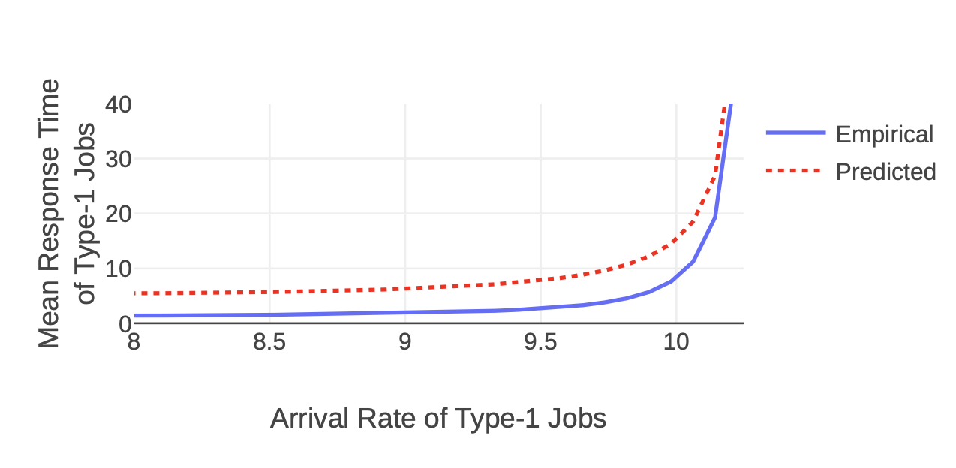
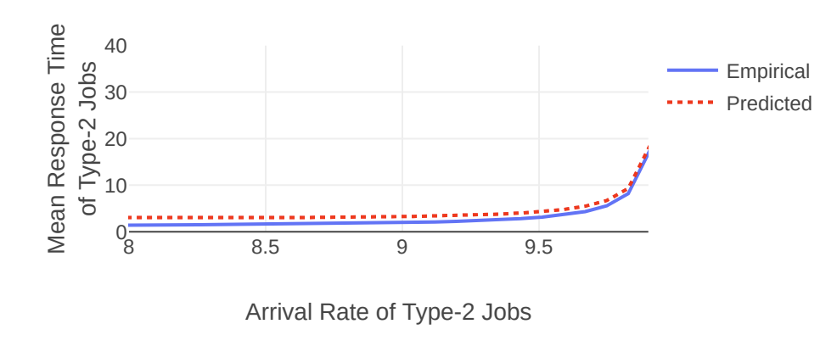
Simulation Results

Slide 26
Our Model of Multiresource Jobs
1G
256 cores
?G
2G
1024 GBs
1G
R Types of Resources
4 cores
1 core
…
? cores
$$S_{i}$$
$$S_{i}∼exp\left(μ_{i}\right), i.i.d.$$
…
2 cores
4 GPUs
128T SSD
Type-2 Job
Type-$K$ Job
…
Type-$i$ Job
Type-1 Job
$K$ Types of Jobs
Type-$i$ jobs share the same resource demands.
Type-$i$ jobs may have different service requirements.
Service requirement: time the job needs to be run on the server before completion.
Note that service requirements are unknown to the server.
We only know about the size distribution of type-$i$ jobs.
Note: $S_{i}∼\exp\left(μ_{i}\right)$ means if we serve $n_{i}$ type-i jobs, we are completing the jobs at a rate of $n_{i}μ_{i}$ jobs/sec.
Notes:
Generalize from exponential to phase-type
Similar pictures to earlier ones

Slide 27
Multiresource Jobs in Data Centers
Response time, $T$
Job arrivals
Question 1: $𝔼\left[T\right]$ bounded? Under what conditions?
Question 2: If so, can we minimize $𝔼\left[T\right]$?
Goal 1: Maximize stability region – set of conditions s.t. $𝔼\left[T\right]$ bounded.
Goal 2: Minimize mean response time, $𝔼\left[T\right]$.
Notes:
Our general goal is to minimize response time across jobs. However, response time may blow up to infinity under some conditions. For example, when the jobs are arriving at a rate much faster than the complete, the

Slide 28
Scheduling Multiresource Jobs
1G
Stream of arriving jobs
Completes and releases resources
4 cores
$λ_{1}$ jobs/sec
1G
$λ_{2}$ jobs/sec
1 core
$λ_{3}$ jobs/sec
CPU
3G
0/5 cores
2/5 cores
3/5 cores
5/5 cores
1 core
Memory
0/5 GBs
2/5 GBs
3/5 GBs
2/5 GBs
Reserves resources
2G
Scheduling policies chooses which jobs to run
Objective 1: Maximize stability region
Objective 2: Minimize $𝔼[T]$ — the mean response time
$λ_{4}$ jobs/sec
2 cores
Notes:
We consider the case where a stream of these jobs are arriving over time

Slide 29
How to schedule multiresource jobs?
How to maximize stability region?
How to minimize mean response time $𝔼[T]$?
Minimize Wastage
1G
3G
1G
1G
3G
2 cores
2 cores
4 cores
2 cores
5 cores
CPU
0/6 cores
5/6 cores
6/6 cores
Memory
0/6 GB
1/6 GB
6/6 GB
We first assume free preemptions are allowed.
Later: limited preemptions.

Slide 30
E[T] bounds
constant rate
penalty for switching
1
2
penalty for running jobs in parallel
where
and
An important observation:
What will happen if we limit the rate of preemption?
Notes:
Load => same as constant rate system
penalty for switching

Slide 31
Instantaneous Completion Rate and Stability
Plan here: introduce long-run completion rate $μ^{∗}$ and instantaneous completion rate $μ(t)$.
Argue that more wastage leads to smaller and $μ(t)$.
The system is stable when $μ^{∗}>λ$.
Because we want to sustain maximal arrival rate,
we want to reduce wastage and maximize $\hat{μ}$.
1G
Stream of arriving jobs
4 cores
$λ_{1}$ jobs/sec
1G
$λ_{2}$ jobs/sec
Completion rate
1 core
3G
$λ_{3}$ jobs/sec
1 core
2G
$λ_{4}$ jobs/sec
2 cores
Notes:
Let’s consider the case where wastage leads to a lower completion rate.

Slide 32
Foster-Lyapunov Theorem
Test Function
A measure of the system state — queue lengths.
We use L2 norm here.
Drift
Expected change in test function starting from a system state after some time t.
Theorem
If the drift is positive only for a finite number of states, then the system is stable.

Slide 33
How to schedule multiresource jobs?
First-Come-First-Served (FCFS)
Maximize Number of Jobs Running
Minimize Wastage
3 cores
4 cores
1G
Queue
2G
Latest arrival
Earliest arrival
3G
1 core
3/5 cores
4/5 cores
4/5 cores
0/5 cores
0/5 cores
3/5 cores
4/5 cores
5/5 cores
Preempt!
0/5 GBs
3/5 GBs
3/5 GBs
1/5 GBs
0/5 GBs
3/5 GBs
5/5 GBs
1/5 GBs
FCFS
Smarter Scheduler

Slide 34
How to schedule multiresource jobs?
First-Come-First-Served (FCFS)
Maximize Number of Jobs Running
Minimize Wastage
3 cores
4 cores
1G
Queue
2G
Latest arrival
Earliest arrival
3G
1 core
3/5 cores
4/5 cores
4/5 cores
0/5 cores
0/5 cores
3/5 cores
4/5 cores
5/5 cores
Preempt!
0/5 GBs
3/5 GBs
3/5 GBs
1/5 GBs
0/5 GBs
3/5 GBs
5/5 GBs
1/5 GBs
FCFS
Smarter Scheduler

Slide 35
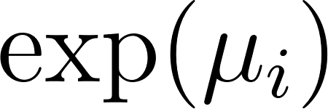
Our Model of Multiresource Jobs
for type-i jobs
1G
3G
Poisson arrival across same job type
1 core
…
1s
10s
4 cores
2s
1s
1G
2G
1 core
2 cores
Queue
Latest arrival
Earliest arrival
K Types of Jobs
256 cores
1024 GBs
i.i.d. sampled
R Types of Resources
4 GPUs
128T SSD
…
Type-1 Job
Type-2 Job
Type-3 Job
Type-4 Job
Type-i Job

Slide 36
Queueing Dynamics
We care about:
Capacity Region
Set of arrival rates such that the system is stable, which implies the mean queue length is finite.
Mean Response Time
Mean Response Time = Mean Queue Length / Arrival rate (Little’s Law)
Jobs arrive according to Poisson process
Scheduling algorithm selects jobs to serve and holds resources needed
Jobs complete and release the resources

Slide 37
Our Model of Multiresource Jobs
1G
256 cores
2G
1024 GBs
1G
3G
R Types of Resources
4 cores
1 core
1 core
2 cores
2 sec
i.i.d. sampled
4 GPUs
128T SSD
…
Type-1 Job
Type-2 Job
Type-3 Job
Type-4 Job
Type-i Job
We assume there are K types of jobs.
Type-i jobs share the same resource demands.
Each job has a service requirement — time to complete the job.

Slide 38
Our Ideas: Modulated Service Rate (MSR)
A set of algorithm that:
Uses a Continuous Time Markov Chain (CTMC) to modulate among pre-selected schedules.
0.1
Schedule 1
0.4
Schedule 2
0.1
0.2
10.0
Schedule 3
2.0

Slide 39
Theorem
If , then the system is stable under MSR.
The converse is easy to show, since there will be more jobs arriving than departing that will blow the queue lengths up.

Slide 40
Proof Sketch
When queues are long, drift is negative following from the assumption .
When queues are short, we can show that those cases are finite.

Slide 41
MSR is throughput-optimal
By [1], if an algorithm can stabilize the system when , then the algorithm is throughput-optimal.
Remember the converse of the theorem implies no algorithm can stabilize such arrival rates.
[1] Siva Theja Maguluri and Rayadurgam Srikant. 2013. Scheduling jobs with unknown duration in clouds. IEEE/ACM Transactions On Networking 22, 6 (2013), 1938–1951.

Slide 42
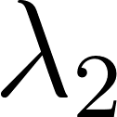
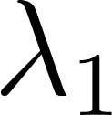
Our Ideas: Modulated Service Rate (MSR)
Known arrival rate
Completion rates from feasible schedules
Average Completion rate by modulating among schedules
If completion rate > arrival rate for each dimension, then the queue length is bounded. We say the system is stable in this case.
Throughput vs mean response time: throughput here is defined as the set of all arrival vectors such that the system is stable under a scheduling policy. We will show that MSR achieves maximal throughput while having good mean response time.
Notes:
No single feasible schedule yields stability =>
Combination of feasible schedules

Slide 43
Our Ideas: Modulated Service Rate (MSR)
Known arrival rate
Completion rates from feasible schedules
Average Completion rate by modulating among schedules
Our main theorem: The system is stable if the average completion rate is larger than arrival rate for each dimension.
Our main theorem: The system is stable if the average potential completion rate is larger than arrival rate for each dimension.
2/4 cores
4/4 GBs
Schedule: (0,2)
Note: The actual completion rate may be lower when there are not enough jobs in the queue.

Slide 44
Our Ideas: Modulated Service Rate (MSR)
Now that we have shown we can pick only K schedules to stabilize the system, we need to specify which schedule to pick at time t.
We use a Continuous-Time-Markov-Chain (CTMC) as a stochastic process to randomize the schedule at time t.
Schedule 1
Schedule 2
Schedule 3

Slide 45
Example: Solve for Average Completion Rate
Solving the CTMC on the left, we know that we are in schedule (0, 2) half of the time and (2, 0) half of the time.
1
(2, 0)
(0, 2)
1
Then, the time average schedule would be
0.5 (0, 2) + 0.5 (2, 0) = (1, 1).
The average completion rate would be .
As long as average completion rate > arrival rate, the system is stable.

Slide 46
Picking the Candidate Set
Theorem: If the given arrival vector can be stabilized, there exists a CTMC with at most K states that can stabilize the system.
This follows from Carathéodory Theorem.
Now, we have shown that MSR can stabilize all arrival rates if possible — that is, MSR achieves maximal throughput. We next show that we can analyze mean response time given the arrival rates and MSR CTMC.

Slide 47
Using MSR-1 to bound MSR
Recall that the MSR algorithm selects the schedule according to the following CTMC.
If we only look at a single resource, the mean queue length is the same as the MSR-1 system.
0.1
Schedule 1
0.4
Schedule 2
0.1
0.2
10.0
Schedule 3
2.0

Slide 48
Does an MSR policy with bounded mean response time exist?
Recall that the mean response time is bounded when time-average completion rate is larger than arrival rate.
Arrival / completion rate of type-2 jobs
It exists if the arrival rate is in the convex hull of all schedules.
Schedule 3
Moreover, if the arrival vector is given, we can pick K (number of job types) schedules so that the arrival vector lies within the convex hull of these K schedules.
Time-average schedule
Schedule 2
Arrival / completion rate of type-1 jobs
Notes:
many possible ways to pick the schedules – shaded area

Slide 49
Does a simple policy exist?
MaxWeight is a scheduling policy that achieves bounded mean response time for every possible arrival rate vector.
The catch: we need to solve a complex optimization problem at each step.
The complexity of MSR algorithms depends on the number of schedules.
If the arrival rates are given, we can pick only K schedules, giving us a simple policy.

Slide 50
How to pick an MSR policy?
Lower mean response time!
To compare MSR policies, we need a way to analyze their mean response times.
Minimizing mean response time ⇔ Minimizing mean queue lengths.
We decompose the multiserver job model to K different systems, and compare each to a system we know how to analyze.

Slide 51
How to minimize the mean queue lengths of type-i jobs?
We derive bounds on the mean queue lengths.
We compare the mean queue length of type-i job to MSR-1 systems.

Slide 52
MSR-1 Systems vs Multiserver Job Systems
Queue
Server Capacity
4 cores
4 GBs
0.5
1
2
Schedule 2
Schedule 3
Server runs at 1x the speed
Server runs at 2x the speed
1.5
Schedule 4

Slide 53
Our Approach vs Prior Work
We achieve all at the same time:
Low Complexity
Analyzable Response Time
Maximum Throughput

Slide 54
Why is it hard?
Each job occupies the entire server
Arrivals
Traditional queueing-theoretic models
Wastage
Jobs complete
Server (busy)
Server (idle)
1G
3G
1 core
wastage
4 cores
3/4 cores
Jobs (VMs / Applications)
1G
2G
VM Hosts / Server
1 core
3/4 GBs
2 cores

Slide 55
Model Assumptions
Server Capacity can be (256 cores, 256G memory, 1TB disk, …)
types of jobs. Jobs of the same type share the same resource demands.
Service requirement: the time it takes to complete a job.
Service requirements of type-i jobs are sampled i.i.d. from an exponential distribution .
Arrival process of type-i jobs follows .
Type-1 Job: (128 cores, 128G memory)
Server Capacity
256 cores
A server that runs 2 type-1 jobs and 4 type-2 jobs
Type-2 Job: (64 cores, 128G memory)
256G memory

Slide 56
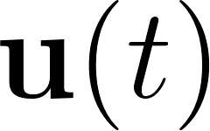
Schedules
How many jobs of each type are put into service.
If the server can serve all jobs in the schedule at time same time, we call this schedule a feasible schedule.
denotes the schedule at time t.
Type-1 Job: (128 cores, 128G memory)
Examples of Feasible Schedules
Schedule: (2 Type-1 Jobs, 4 Type-2 Jobs)
Schedule: (3 Type-1 Jobs, 1 Type-2 Job)
Type-2 Job: (64 cores, 128G memory)

Slide 57
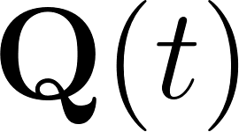
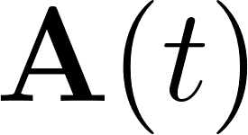
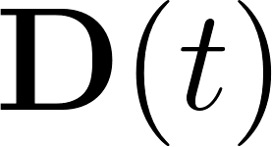
Queueing Dynamics
— the number of jobs of each type in queue.
— queue lengths at time t.
— cumulative arrivals of each type up to time t.
— cumulative departures of each type up to time t.
Type-1 Job: (128 cores, 128G memory)
Type-2 Job: (64 cores, 128G memory)

Slide 58
More on Queueing Dynamics
Let .
because of Poisson arrivals.

Slide 59
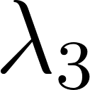
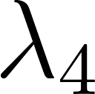
Another perspective of the queue
Given wastage, when is completion rate > arrival rate?
jobs/sec
Completion rate of type-1 jobs
Key Difference:
Jobs in our model follow different distributions.
Queue for type-1 jobs
All queues are stable => The system is stable.
jobs/sec
Completion rate of type-2 jobs
Queue for type-2 jobs
When stable, throughput == arrival rate
jobs/sec
Completion rate of type-3 jobs
What does it mean by maximizing throughput?
Queue for type-3 jobs
A: Make more arrival rates stable.
Note: throughput here is the set of all arrival rates such that the system is stable.
Completion rate of type-4 jobs
jobs/sec
Queue for type-4 jobs
Notes:
When the system is stable, throughput equals to the completion rate because:
There are only this many jobs arriving at the system
The queue is bounded

Slide 60
Performance Metrics
Mean Response Time (Latency)
Throughput: The set of arrival rates s.t. the system is stable.
Some Ideas on scheduling Multiresource Jobs:
FCFS (First-Come-First-Served)
Minimize Wastage
Maximize # Jobs in Service

Slide 61
State-of-the-art Multiresource Scheduling Policy
MaxWeight Policy (Maguluri 2013): Maximize weighted # of jobs in service
😊 Maximizes throughput
😊 Good response time performance
😢 Solves a bin-packing problem continuously
😢 Response time too complex to analyze
Randomized Timer (Ghaderi 2016):
😊 Maximizes throughput
😊 Simple policy
😢 Bad response time performance
😢 Response time too complex to analyze
Our result: Response time analysis on simple and throughput-optimal policies

